Slide 1
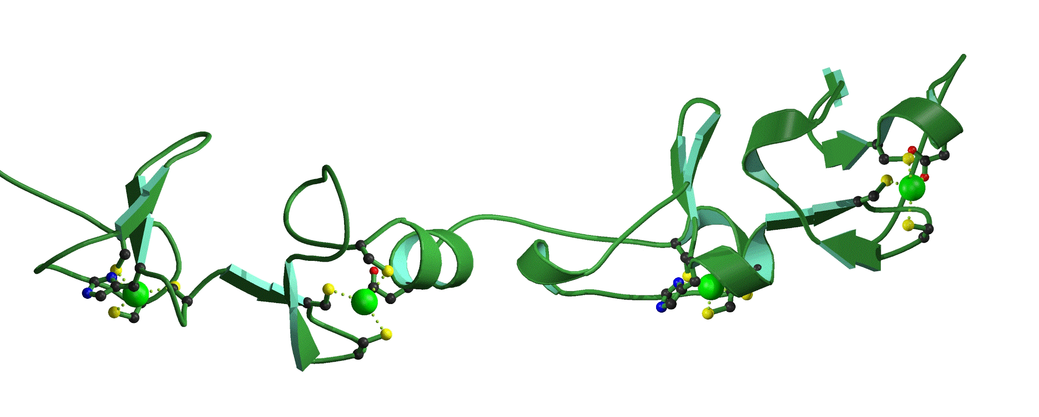

Nailing Down the Immunophathogenesis of Psoriatic Disease
Leeds Institute of Molecular Medicine
Dennis McGonagle PhD FRCPI
Academic Unit of Musculoskeletal Disease
University of Leeds
United Kingdom

Slide 2
Learning Objectives
Understanding the anatomy of the nail and local ligamentous and tendinous insertions
Understanding the MRI and histopathological features of the nail and enthesis unit
Learn how classification of psoriatic disease may improve based on an improved understanding of the nail

Slide 3
Spondylarthritis-The Common Thread
Undifferentiated
SpA
Juvenile
SpA
Psoriatic
Arthritis
Ankylosing
Spondylitis
Acute
anterior
uveitis
Reactive
arthritis
Arthritis
associated with
Colitis /
Crohn’s disease
_{Psoriatic Arthritis- A} Unified Concept. Wright V. Arthritis Rheum 1978

Slide 4
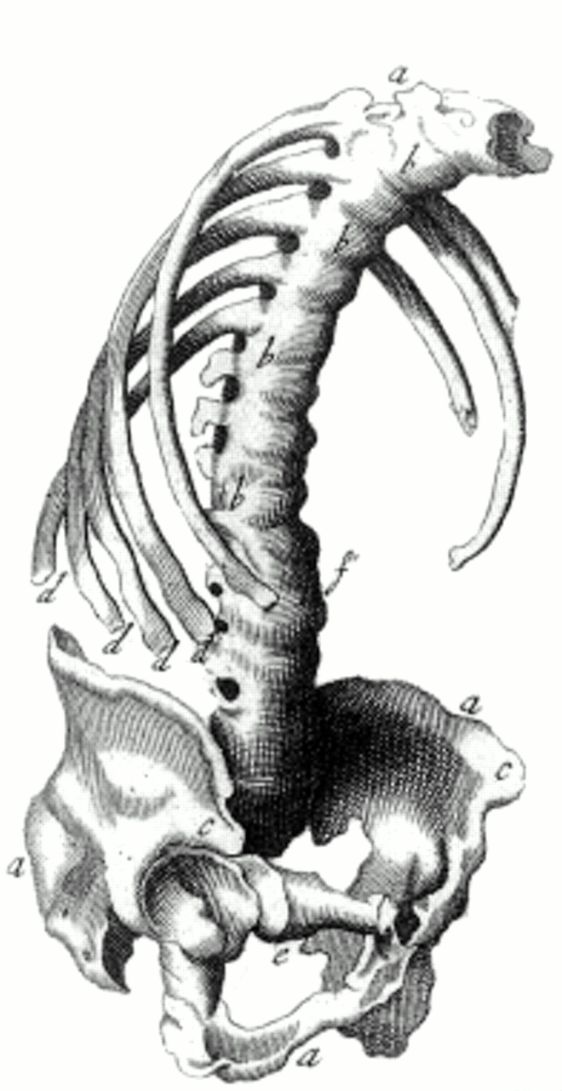
The Celts And Spondylarthritis
Ank Spond - Bernard Connor
Philosophical Transactions 1695
Wright – A Unified Concept 1960-80
Sturrock et al HLA-B27

Slide 5
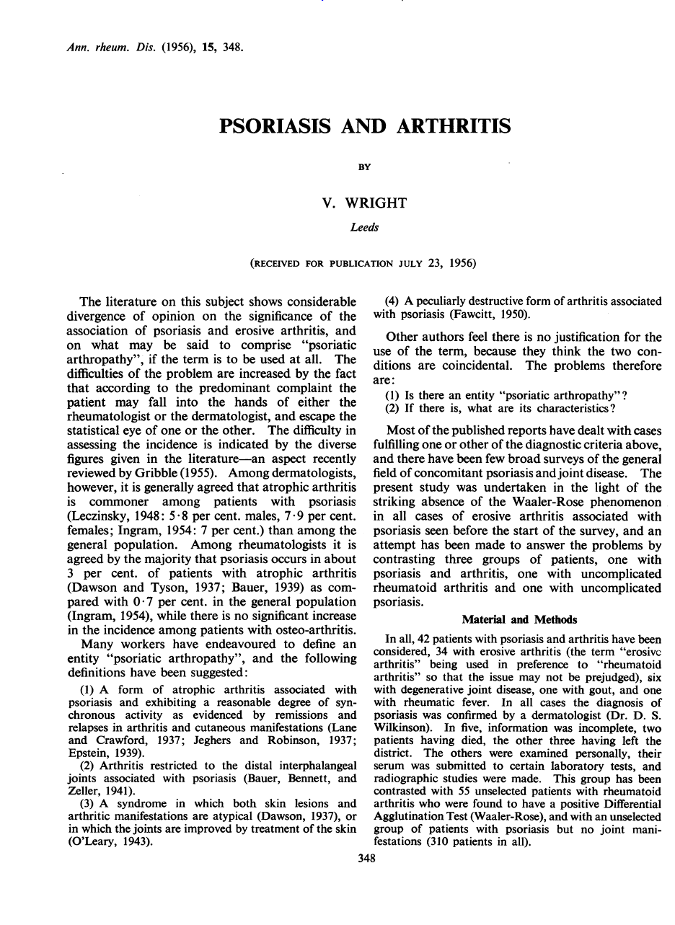
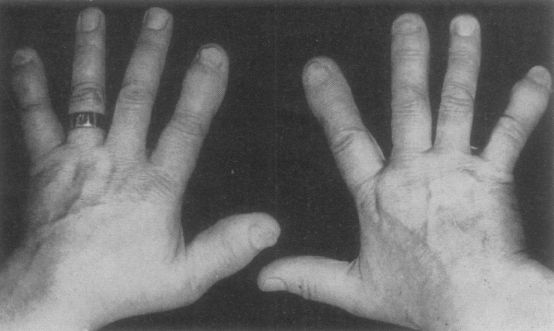
Psoriatic Arthritis Described in Leeds
Nail Disease linked to PsA
More strongly than psoriasis

Slide 6
Psoriatic Disease Concept
Skin
Psoriatic
Disease
Joints
Nails

Slide 7
Clinical Subgroups of PsA
Monoarticular or asymmetric oligoarthritis with dactylitis
Symmetric polyarthritis similar to rheumatoid arthritis
Classic psoriatic arthritis confined to distal interphalangeal joints of hands and feet
Ankylosing spondylitis with or without peripheral joint involvement
Arthritis mutilans

Slide 8
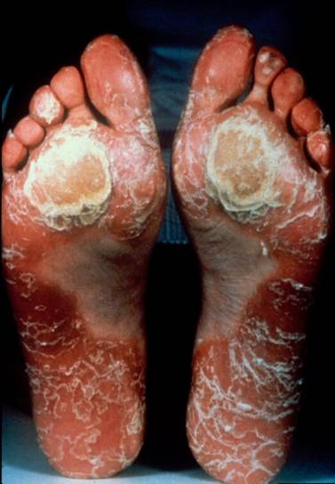
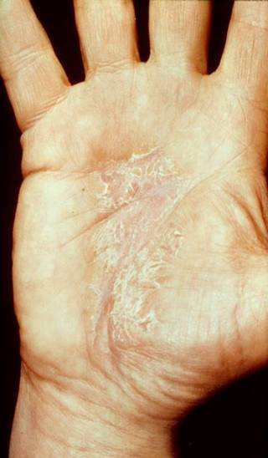
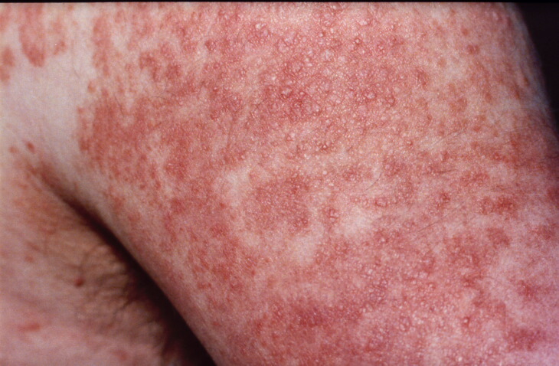
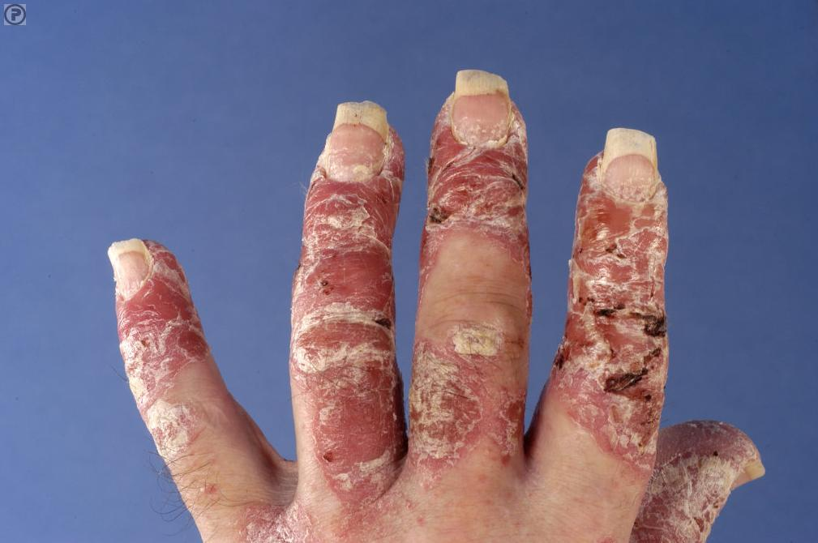
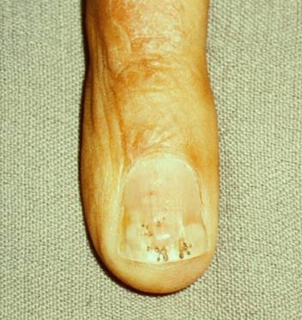

Slide 9
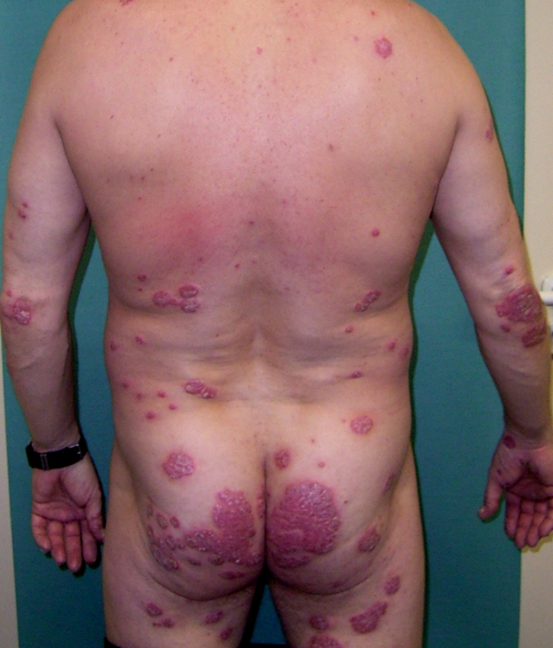
Psoriasis Pathogenesis
The Early Phases of Psoriatic Arthritis. McGonagle et al ARD 2011

Slide 10
Plan of Talk
The Anatomical Basis for PsA in General
The Micro anatomical basis for Nail Disease
Relevance to Dermatology

Slide 11
Plan of Talk
The Anatomical Basis for PsA in General
The Micro anatomical basis for Nail Disease
Relevance to Dermatology

Slide 12
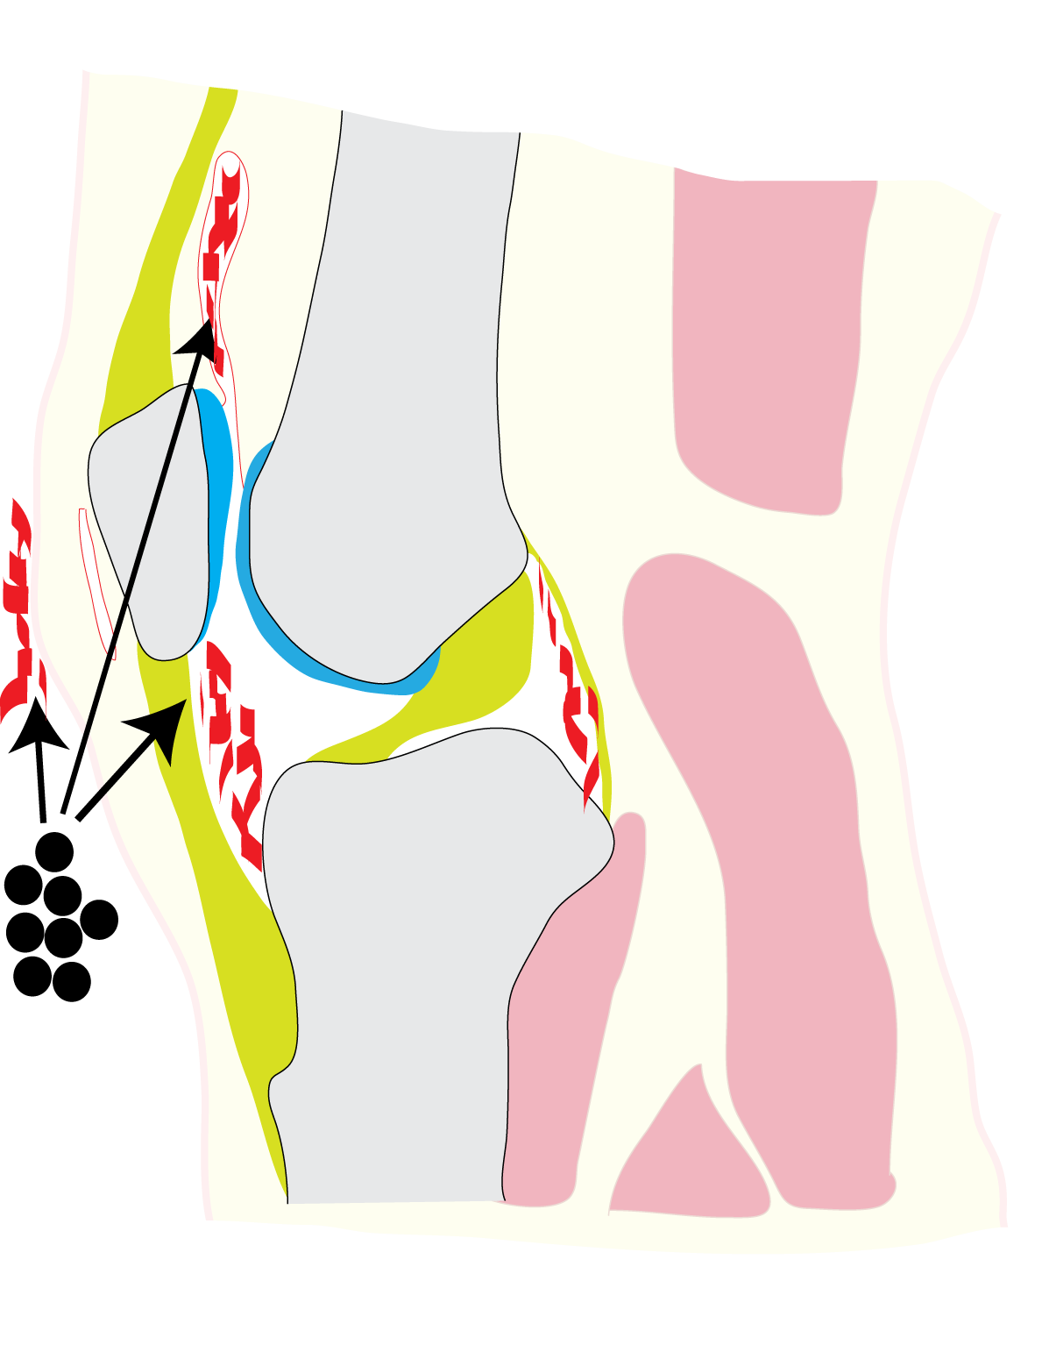
Traditional model of pathogenesis of PsA & psoriasis
T cells
Autoimmunity
Skin/Synovial antigen
T-cells
Inflammation
McGonagle, Tan, Benjamin. Ann Rheum Dis. 2008;67(1):1-4
Notes:
So what has imaging in PsA told us so far about it’s pathogenesis?
The traditional model suggests that T cell directed autoimmunity against a common skin and synovial antigen is responsible for inflammation. However, such an antigen has not been defined

Slide 13
But many of the manifestations of PsA hard to explain in terms of synovial inflammation
Historical lessons from Radiography

Slide 14
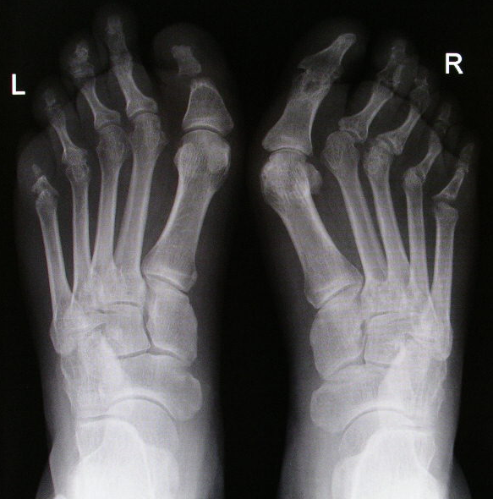
Osteolysis of toes
Notes:
Similar changes can also occur in the feet, with osteolysis and dissolution of bones in the toes.

Slide 15
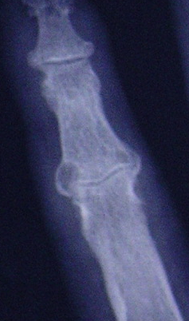
Entheseal new bone
Tan AL, McGonagle D. Imaging of PsA in Atlas of PsA. 2005 Mease & Helliwell, ed.

Slide 16
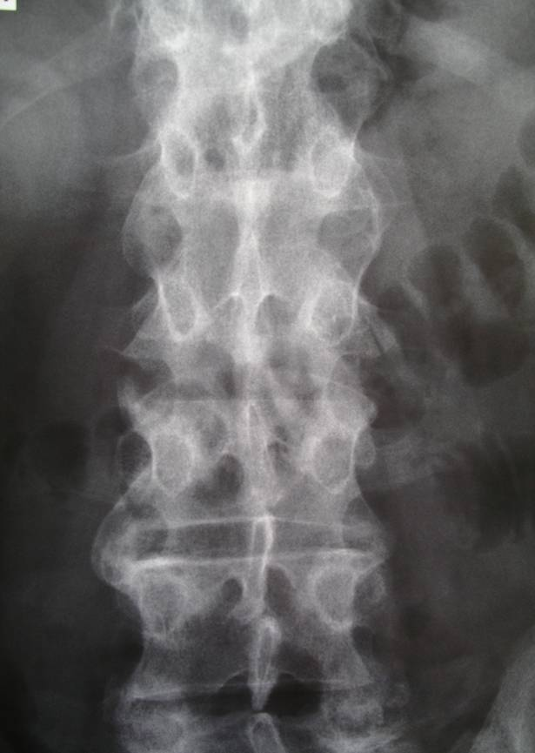
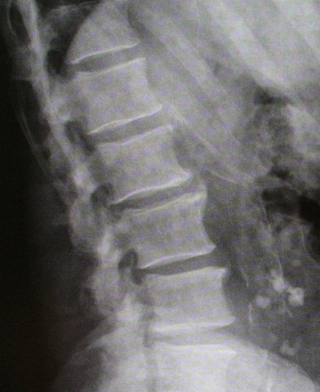
Syndesmophytes or new bone at spinal entheses
Coronal
Sagittal
Notes:
We have seen that new bone formation can occur in the spine. Unlike classical AS spine, the syndesmophytes in PsA tend to be sparse, chunky and asymmetrically distributed

Slide 17
X-Rays usually normal in Early Psoriatic Arthritis

Slide 18
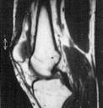
Anatomical Basis for the PsA
T1W MRI Scans

Slide 19
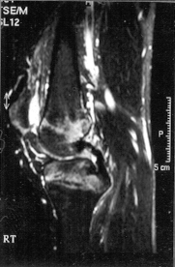
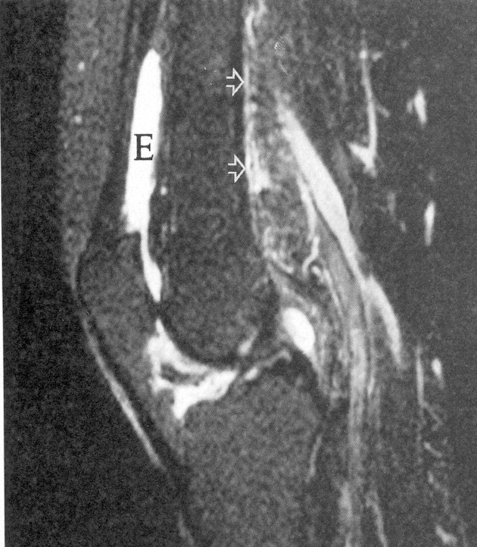
Knee Synovitis- PsA vs RA
PsoriaticArthritis
RA
McGonagle et al, Arthritis Rheum 1998
Notes:
19
This data was published in A&R a few years back. These are two sagittal views from patients with SPA on your left hand side and RA on your R. You can see the different pattern, with abundant bone oedema in the SpA patient but not in the RA.

Slide 20
Anatomical Basis for the Seronegative Arthropathies-Fat Sat MRI Scans
McGonagle et al Arthritis Rheum 1998
Notes:
20
Sagittal images of the knee on MRI of a patient with 5 month history of psoriatic arthritis. This T2-weighted fat suppressed MRI show high signal in the bone where the posterior cruciate ligament attached commonly seen in PsA

Slide 21
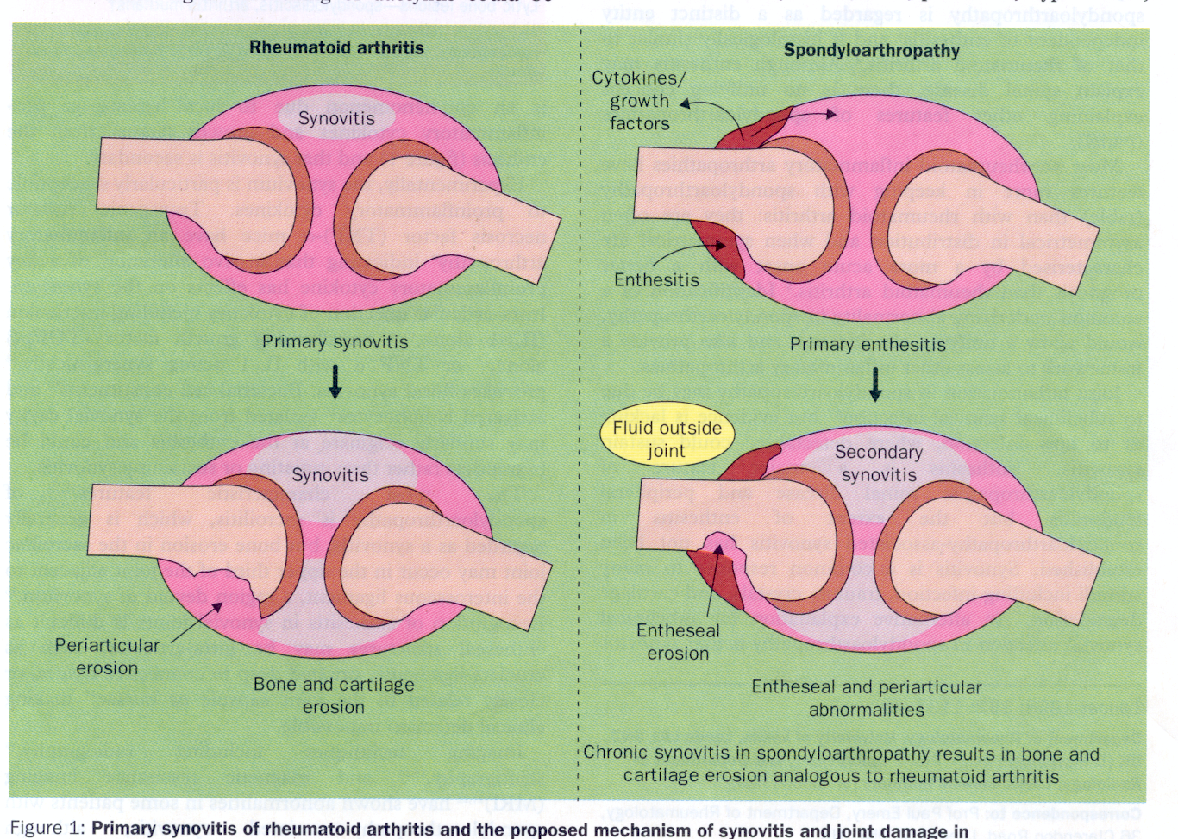
McGonagle et al Lancet 1998

Slide 22
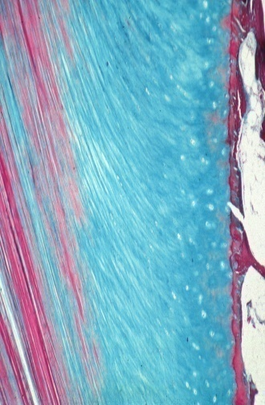
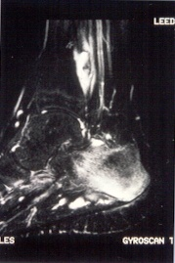
Achilles Enthesis or Insertion
Fibrocartilage
Benjamin & McGonagle J Anatomy 2001
McGonagle et al. Arthritis Rheum 2001

Slide 23
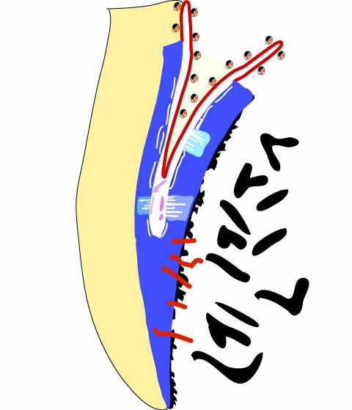
Why Enthesitis is Associated with Diffuse Synovitis
Synovial membrane
Macrophages
Sesamoid fibrocartilage
Periosteal fibrocartilage
Key Message
The Enthesitis Lesion is
Pathologically Diffuse
Enthesis
Osteitis severity linked
to HLA-B27 gene
Synovio-entheseal Complex
McGonagle et al Arthritis Rheum 2001
McGonagle et al Arthritis Rheum 2007
Notes:
It has also been reported that HLA-B27 is related to severity of osteitis in the axial and peripheral skeleton
The genral feeling amongst clinicians is that more severe osteitis ismore predicitive of future radiographic damage but this has not previously been repoted/proven

Slide 24

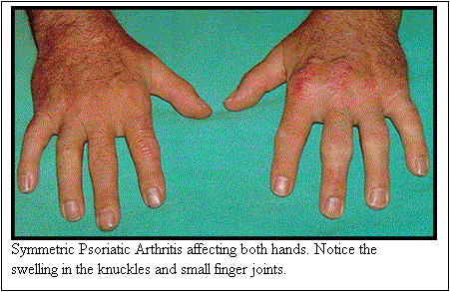
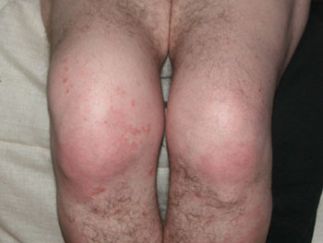
Synovitis in Psoriatic Arthritis

Slide 25
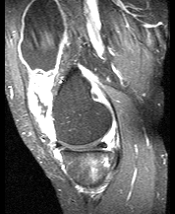
Early PsA features on Imaging
*
*
*
*
Tan AL, et al. What imaging has told us about PsA. Rheumatology in Practice. 2008;5(4)
Notes:
In light of the rapid advancement in biological therapy in the effective treatment for PsA, it is now relevant and important to be able to diagnose PsA early.
This figure shows enthesitis within a synovial joint in PsA that is not clinically apparent. There is extensive perientheseal osteitis adjacent to the semimembranosus insertion. Knee synovitis and effusion is also present (asterisks).

Slide 26
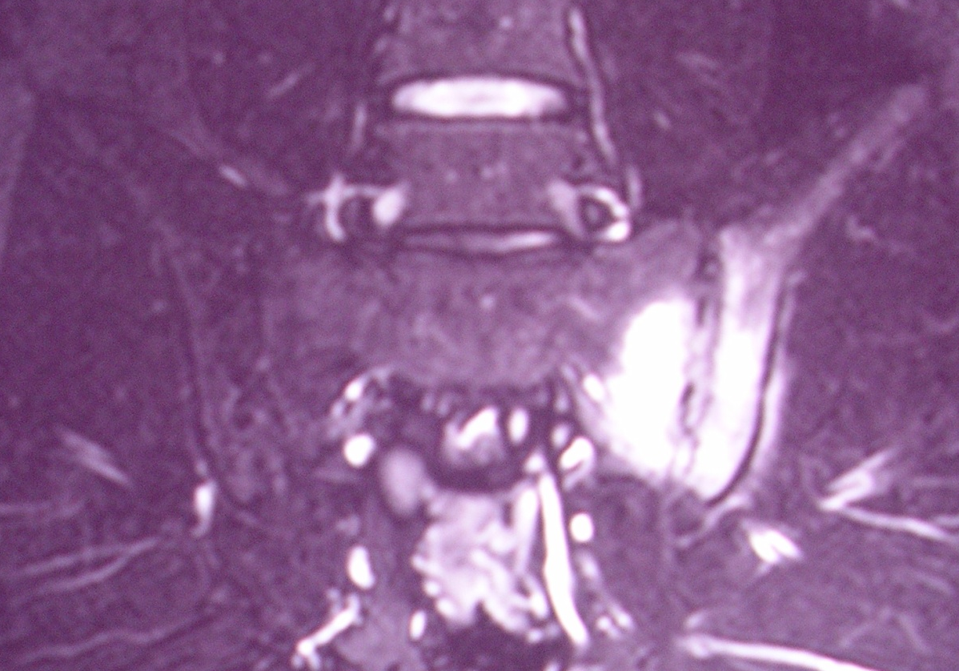
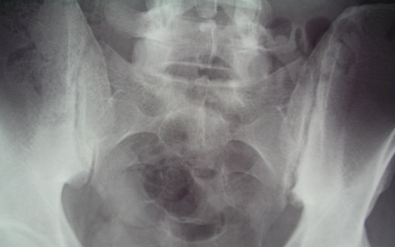
40% of Psoriatic Arthritis Cases get Spinal Inflammation: MRI confirms primary Enthesitis and Osteitis
Tan AL, McGonagle D. Imaging of PsA in Atlas of PsA. 2005 Mease & Helliwell, ed.
Notes:
It has also been reported that HLA-B27 is related to severity of osteitis in the axial and peripheral skeleton
The genral feeling amongst clinicians is that more severe osteitis ismore predicitive of future radiographic damage but this has not previously been repoted/proven

Slide 27
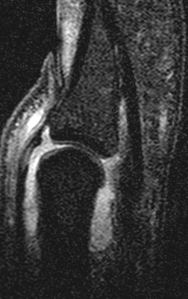
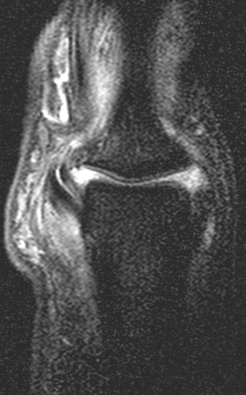
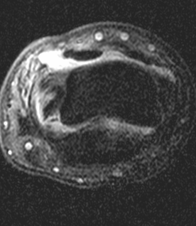
Enthesitis is evident on high resolution MRI in Dactyliits
*
*
Sagittal
Coronal
Axial
High-resolution MRI
T1-weighted fat suppressed post contrast
Eshed, et al. Ann Rheum Dis. 2007;66(12):1553-9
Notes:
Enthesitis has a prominent role in the phenotype of dactylitis. Here are 3 different sections of the same thumb with dactylitis. In all 3 planes, synovitis and perientheseal soft tissue oedema is evident, especially around the nail bed. The sagittal image shows increased signal in the extensor tendon corresponding to a site where fibrocartilage formation is known to occur within the fused extensor tendon-joint capsule. This is a type of functional enthesis. On the coronal section, there was Significant unilateral collateral ligament involvement with associated bone marrow edema at the enthesis.

Slide 28
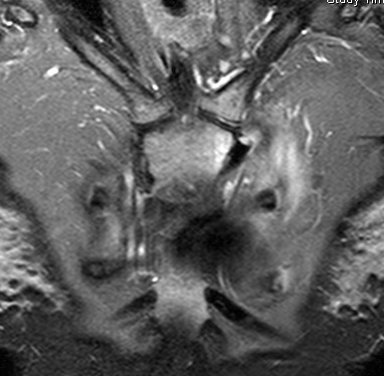
SAPHO Syndrome- A Rare PsA Variant
Histology- Acute Neutrophilic Inflammation

Slide 29
The Enthesis and the Bone

Slide 30
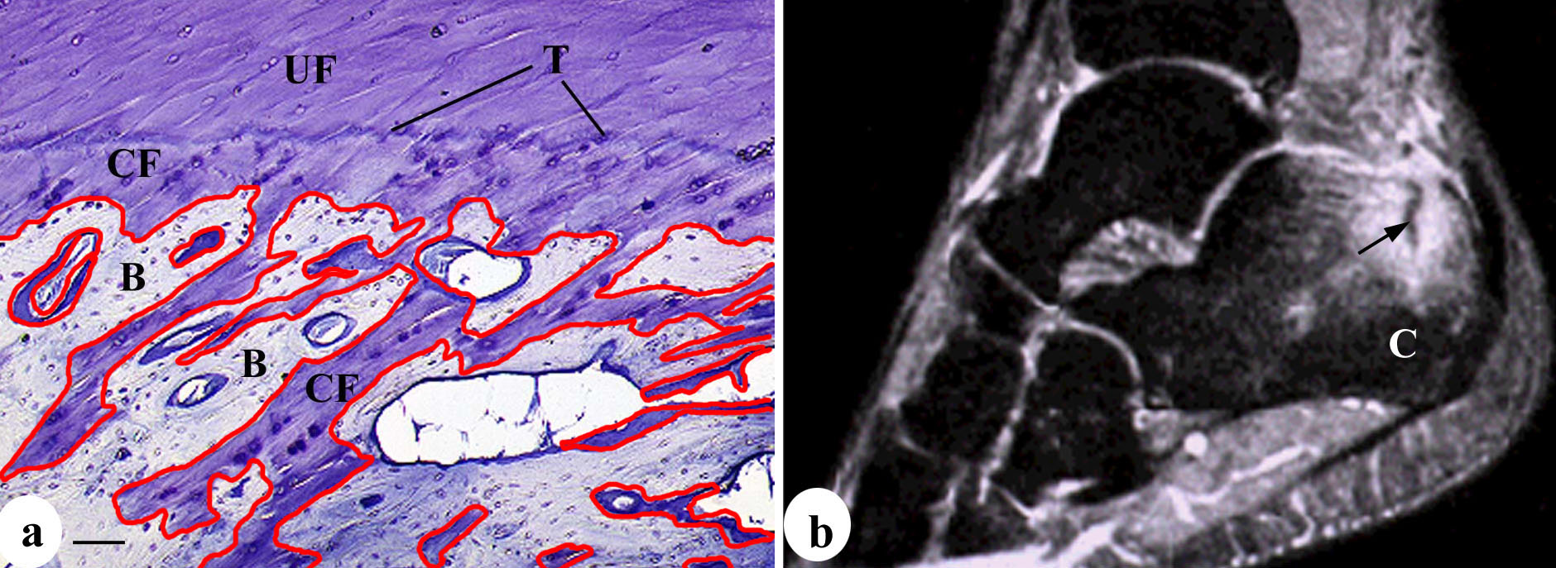
Why is Enthesitis linked to Osteitis- No Bone Cortex at Attachments
McGonagle et al Arthritis Rheum 2002

Slide 31
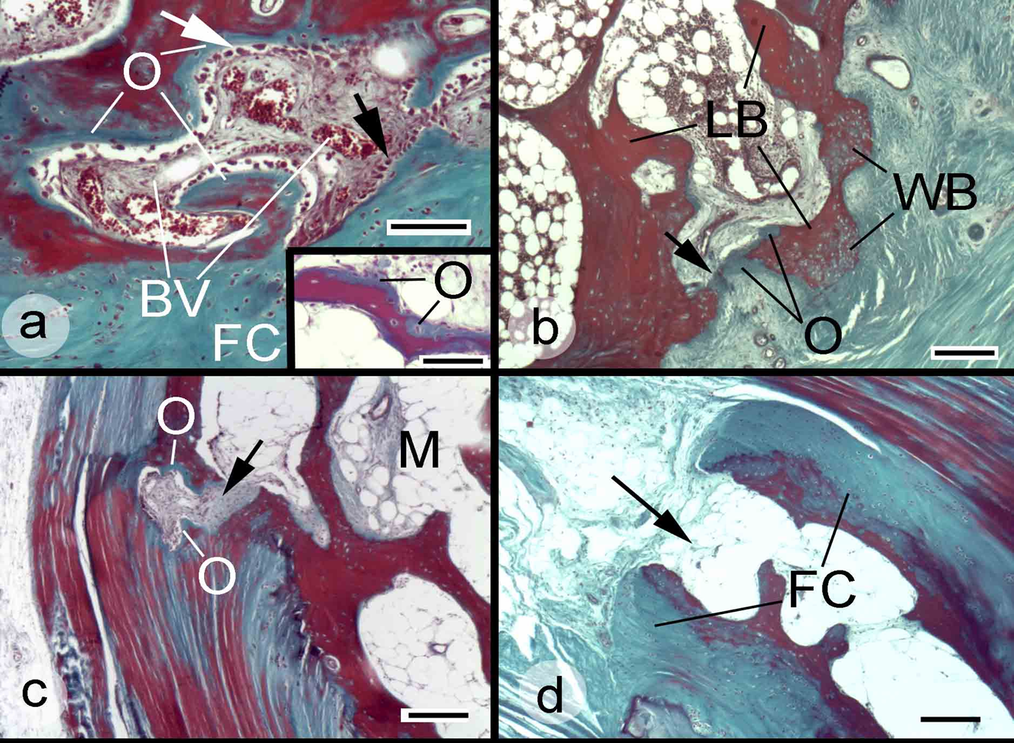
Normal Entheses have bone microdamage at attachments (This is where MRI Osteitis may start)
Benjamin et al 2007

Slide 32
Plan of Talk
The Anatomical Basis for PsA in General
The Micro anatomical basis for Nail Disease
Relevance to Dermatology

Slide 33
Insertion site inflammation is the Common Denominator in PsA
Nail disease may be related to Extensor Tendon Insertion
Enthesopathy

Slide 34
Nail Disease and Arthritis
Nail Disease linked to PsA
More strongly than psoriasis

Slide 35
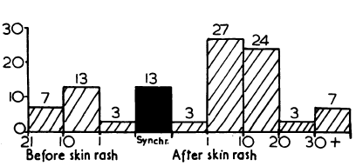
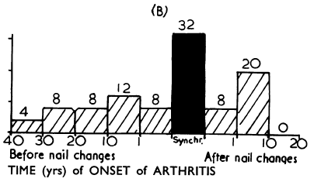
Nail Disease strongly linked with PsA
% Patients
% Patients

Slide 36
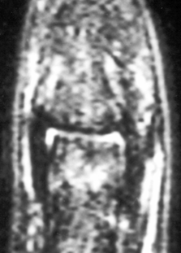
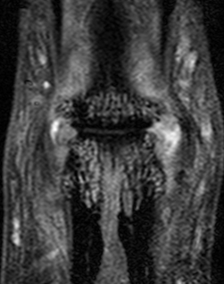
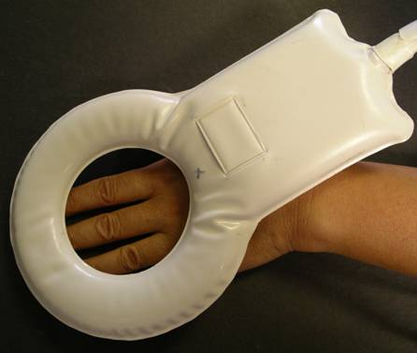
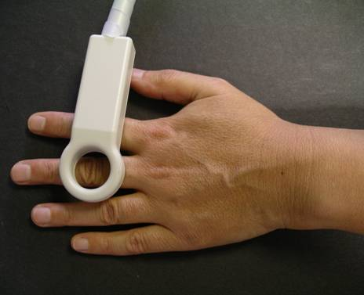
High-resolution MRI, 1.5 Tesla
PsA DIP joint disease
‘Conventional’ MRI coil
23mm diameter microscopy MRI coil
Tan, et al. Arthritis Rheum. 2005;52(8):2355-65
Notes:
But in order to study the small hand joints typically affected in PsA, we need an imaging modality that allows better image resolution.
These are MRI of DIPJ; the most obvious difference between the 2 is the resolution of the images. This is because the DIPJ on the left is scanned using a more commonly used MRI hand coil, whilst the DIPJ on the right is scanned using a 23mm microscopy MRI coil that allows an in-plane resolution of 80-100micrometers, which is required to study small joints like the dip joint

Slide 37
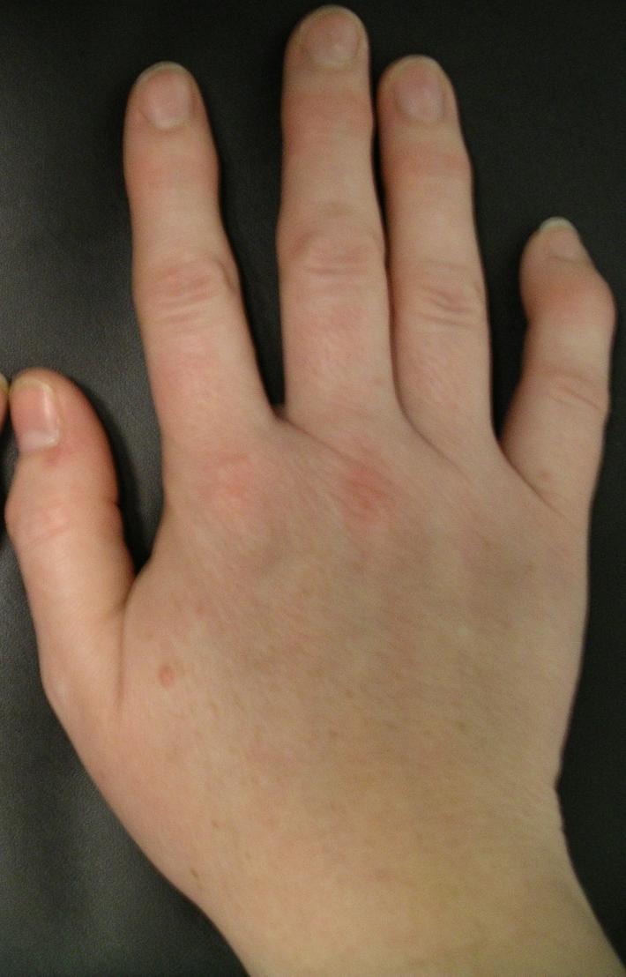
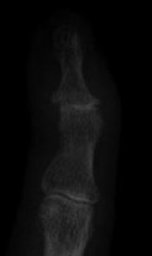
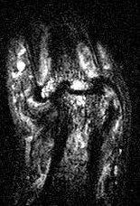
8 month history symptomatic PsA Distal Interphalangeal joint
Tan AL, McGonagle D. Imaging of PsA in Atlas of PsA. 2005 Mease & Helliwell, ed.
Notes:
(a) A patient with PsA who had an 8-month history of symptomatic DIP joint involvement in the little finger showing ankylosis of the joint. (b) Plain radiograph of the same joint showingsubluxation and loss of joint space. (c) On
T2-weighted fat-suppressed high-resolution MRI we can see bone edema depicted by a high signal, particularly near the joint and the enthesis where the collateral ligaments insert. The advantages of MRI over plain radiography in PsA include absence of ionizing radiation, the ability to perform multiplanar imaging, the ability to detect inflammation, and better sensitivity in early disease [6]. In addition high-resolution MRI using specialised MRI 'microscopy coils',
ideal for examination of small joints like in the fingers, has allowed us to identify micro-anatomical differences between PsA and osteoarthritis of the DIP joint [29].

Slide 38
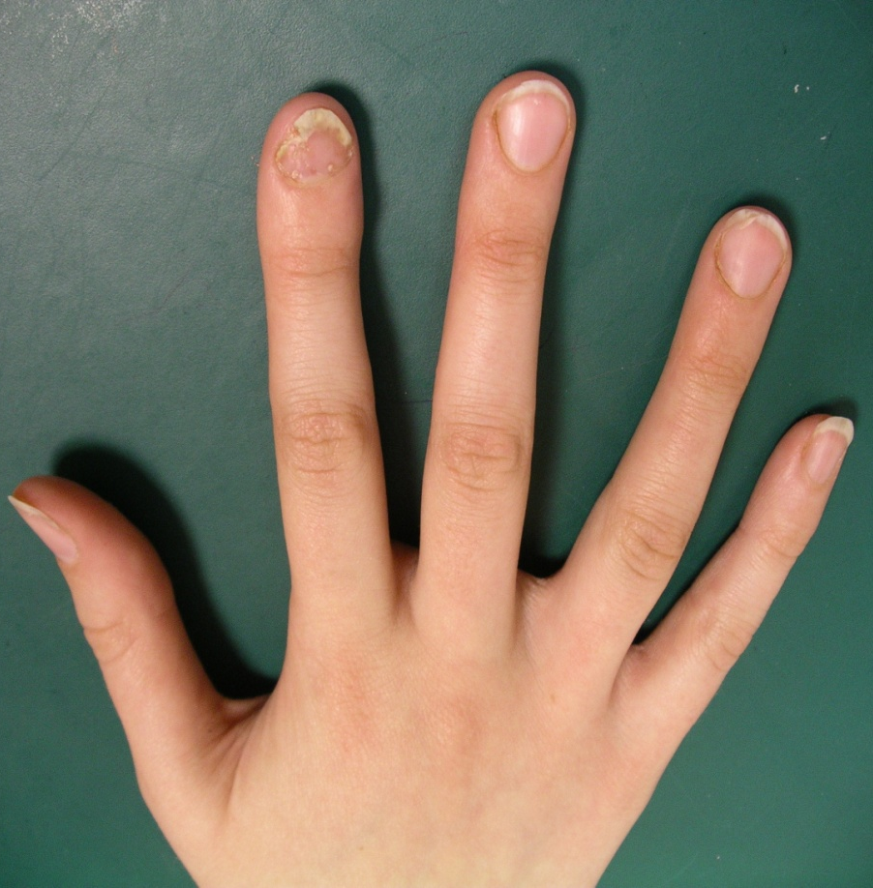
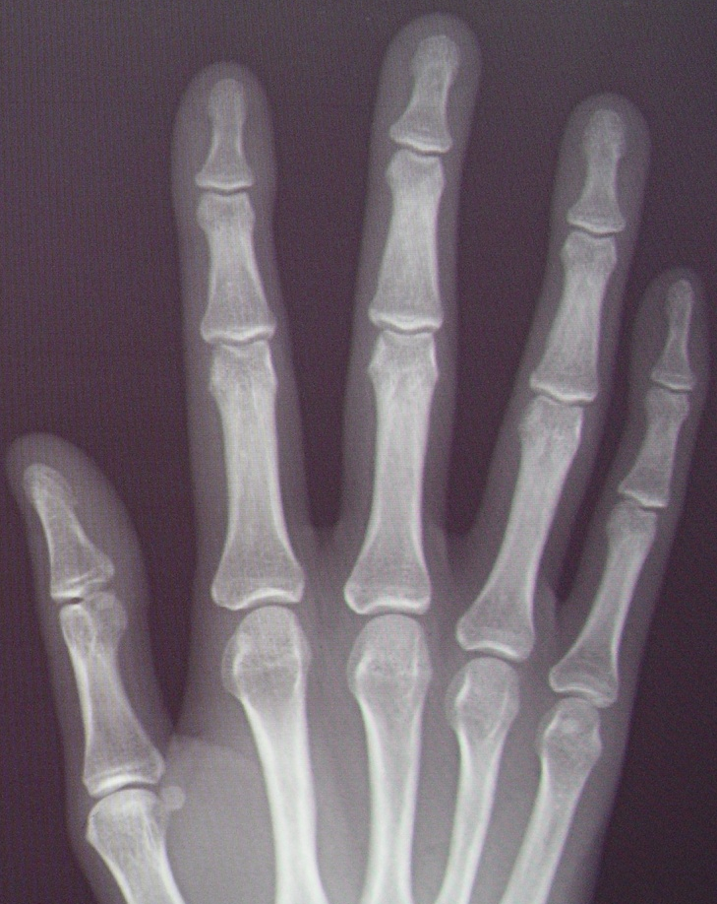
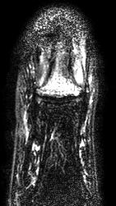
5 month DIP joint symptoms
Notes:
This patient with psoriatic nail changes of the index finger had a normal x-ray appearance, but significant enhancement on the distal phalange on hrMRI

Slide 39
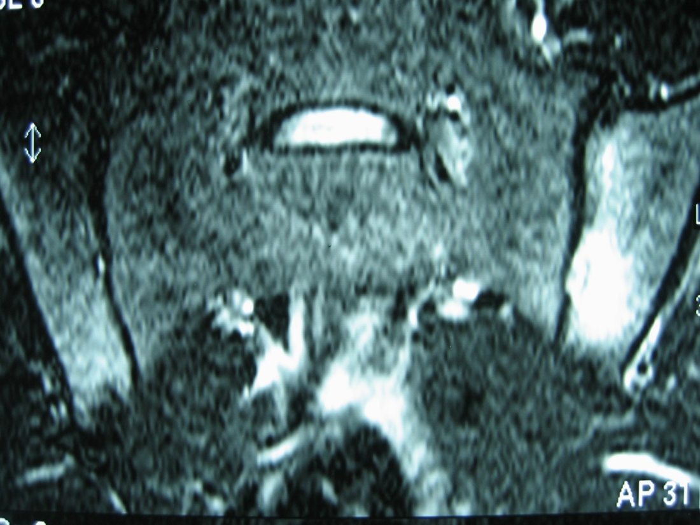
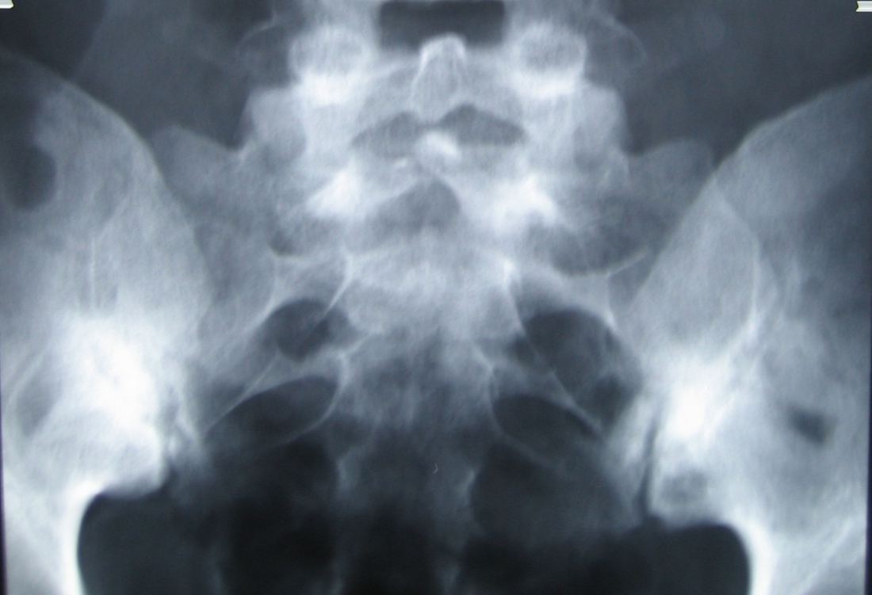
GRADE 3
SPECIFICITY 92%
LIKELIHOOD RATIO 8.0
mNYc AS
HLA-B27
Bennett et al Arthritis Rheum 2009

Slide 40
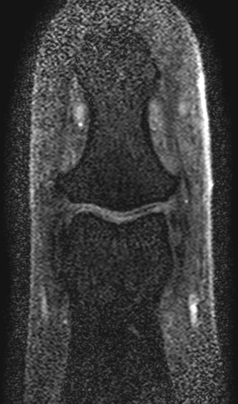
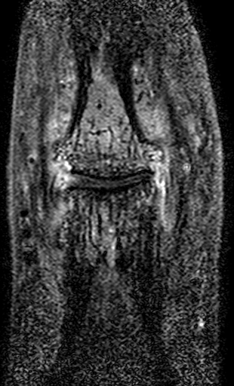
High-resolution MRI
*
*
Normal
PsA
Tan AL, et al. What imaging has told us about PsA. Rheumatology in Practice. 2008;5(4)
Notes:
This high-resolution MRI of a PsA DIP joint shows enhancement in both the bone and the soft tissue, especially around the nail bed.

Slide 41
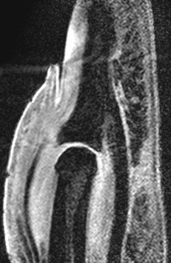


hrMRI – PsA DIPJ
29 year-old female, 3 year PsA
Normal
*
PsA
*
*
Axial
T1-weighted fat-suppressed post gadolinium
Sagittal
Water-selective excitation
Tan, et al. Rheumatology 2007;46(2):253-6
Notes:
high signal of tissues could be seen in the nail bed. The abnormal extensor tendon enthesis with loss of the low signal is evident, and linear regions with low signal similar to the extensor tendon could be seen enveloping the nail, which could be fibres from the extensor tendon extending towards the nail bed.

Slide 42

Sagittal section of DIPJ, Masson’s trichrome
Extensor tendon enthesis
Nail plate
Distal Phalange (DP)
Nail root (NR)
Extensor tendon (ET)
SL = Superficial lamina
DL = Deep lamina
Tan, et al. Rheumatology 2007;46(2):253-6
Notes:
This can be explained better on histology. On this sagittal section We see that the extensor tendon is not only attached to the dorsal aspect of the base of the distal phalanx, but also extended more distally as the superficial lamina of dense fibrous connective tissue to connect with the nail root.

Slide 43


Enthesis connection to the nail at lateral lamina and ligament Complex
*
SF = Skin Fold
M = Matrix
LL = Lateral lamina
Tan, et al. Rheumatology 2007;46(2):253-6
Notes:
the lateral lamina can be found more laterally, formed by the fibrous tissue derived from the flexor tendon indicated by the asterisk
A higher power view of the lateral lamina shows its connection with the nail matrix.

Slide 44
Collateral Ligament and the Nail

Slide 45

Nail Anchorage to Bone Directly via Dermal Ligaments
McGonagle et al Dermatology 2009

Slide 46


Enthesis Nail Interdigitation- Relevant for linear Pitting?
McGonagle et al Dermatology 2009

Slide 47


Optical Coherence Tomography of the Nails
Aydin et al. Dermatology (In Press)

Slide 48
So the Nail is anchored by entheses at multiple points
Extensor tendon
Superficial & deep laminae
Nail
Deep lamina
Flexor tendon
McGonagle et al Dermatology 2009
Notes:
So the finger nail is secured by means of the extension from the extensor tendon dorsally, in fact it is also anchored laterally to fibres from the flexor tendon.

Slide 49

Why is Nail so well Anchored?
Option 1) The Retractable Claw Hypothesis
Option 2) Designed for extra anchorage and strength

Slide 50
Can we use High Resolution MRI to differentiate between PsA and Osteoarthritis?

Slide 51


DIP joint-OA and Psoriatic Similar
*
PsA
OA
Tan, et al. A& R 2006
Notes:
The DIP joints are also commonly affected in OA, and clinically can be difficult to differentiate from PsA DIP joint disease. Using hrMRI, there appear to be similar anatomical changes in both diseases, but there are distinguishing features. The PsA joint had diffuse bone oedema most prominently in the distal phalange with contrast enhancement in the ligaments, and an associated erosion at the enthesis
The collateral ligaments in the OA joint however were degenerative with little enhancement, but there was a focal bone oedema and loss of cartilage.
Note the characteristic enhancement around the nail bed in the PsA joint which is absent in the OA joint

Slide 52


Inflammatory Hand OA-Whole Organ Involvement at Onset
Case Courtesy of Dr Kay-Geert Hermann, Berlin

Slide 53

Corresponding HR MRI of PIP
Case Courtesy of Dr Kay-Geert Hermann, Berlin

Slide 54


Ligament microdamage to explain inflammation in Hand OA
McGonagle et al Rheumatology 2008
Notes:
demonstrating the basis of OA in relationship to the microdamage in the ligaments near the insertions, resulting in inflammation extending inwards and outwards from the sites of ligament insertion (red arrows).

Slide 55


Slide 56

OA Classification by Location of Earliest Anatomical Changes

Slide 57

Anatomical Classification for OA

Slide 58
Plan of Talk
The Anatomical Basis for PsA in General
The Micro anatomical basis for Nail Disease
Relevance to Dermatology

Slide 59
Psoriasis without arthritis is associated with subclinical Enthesopathy

Slide 60

Notes:
In fact similar findings of periarticular uptake have been found using bone scanning over 3 decades ago in patients with skin psoriasis

Slide 61

7.1mm
Clinically asymptomatic patients with psoriasis has entheseal abnormalities on ultrasound
?Early diagnosis of PsA
6.8mm
Notes:
A recent study shows detection of possibility of very early PsA changes.
This study shows that Entheseal abnormalities can be documented by ultrasonography in clinically asymptomatic patients with psoriasis. These findings could be related to a subclinical entheseal psoriatic inflammation. Evidence of enthesophyte and retrocalcaneal bursa can also be seen in these asymptomatic patients with psoriasis.

Slide 62


Clinically asymptomatic polyarticular PsA
Scarpa, et al. J Rheumatol. 2008;35(1):137-41
Notes:
A recent study confirms that asymptomatic joints in PsA patients do deomonstrate increased uptake on bone scan, suggesting that bone scan can be useful in detecting possibly very early changes in PsA joints

Slide 63
Asymptomatic Joint or Entheseal Involvement in Psoriasis Patients
Author |  | Reference
Raza et al. | Detection of subclinical joint involvement in psoriasis with bone scintigraphy and its response to oral methotrexate | Clin Exp Dermatol. 2008;33:70-37
Scarpa et al. Erdem et al. | Bone scintigraphy reveals early clinically asymptomatic joint involvement Magnetic resonance imaging features of foot involvement in patients with psoriasis | J Rheumatol. 2007;35:137-141 Eur J Radiol. 2008;67:521-525
Ozcakar et al. | Ultrasonographical evaluation of the Achilles tendon in psoriasis patients | Int J Dermatol. 2005;44:930-932
De Filippis et al. | Ultrasonography in the early diagnosis of psoriasis-associated enthesopathy | Int J Tissue React. 2005;27:159-162
De Simone et al. | Achilles tendinitis in psoriasis: clinical and sonographic findings | J Am Acad Dermatol. 2003;49:217-222
Offidani et al. | Subclinical joint involvement in psoriasis: magnetic resonance imaging and X-ray findings | Acta Derm Venereol. 1998;78:463-465
Notes:
63
63

Slide 64


Ongoing Studies on 3T MRI and US
Is Nail Disease in Psoriasis without Arthritis indicative of undiagnosed “micro machine” enthesopathy at that site?
Does Nail Disease in Psoriasis equate with a systemic undiagnosed enthesopathy at Distant Sites?

Slide 65

High Resolution 3T MRI Visualisation of Extensor Tendon Slip
PsA
From Zoe Ash & Richard Hodgson

Slide 66


DIP Osteitis seen in psoriasis Nail Disease
Psoriasis with nail disease
Notes:
Here you can see much more subtle changes in psoriasis patients
66

Slide 67

Healthy Subject Ultrasound of Nail
Epidermis and Dermis
Enthesis of the extensor tendon

Slide 68





Psoriasis Nail Disease linked to Enthesopathy
Photographs courtesy of Robert Baran, MD, Cannes (France).
Jiaravuthisan MM, et al. J Am Acad Dermatol. 2007;57:1-27.
Notes:
68

Slide 69

PsA Ultrasound DIP-Enthesopathy linked to clinical Nail Disease
Epidermis and Dermal Thickening
Enthesitis of Extensor tendon and hypoechogenicity

Slide 70
Given that Nail Disease is strongly linked to PsA – could nail disease indicate a systemic undiagnosed enthesopathy?

Slide 71

Nail Disease = Systemic Enthesopathy
P=0.002

Slide 72
A Unifying Concept for Psoriatic Disease and a New Classification scheme by a synthesis of Microanatomical Knowledge and Human Genetics

Slide 73

Introducing Genetic Limits on Immune Concepts
Innate Immune Boundary
Monogenic
Autoinflammatory
Diseases
Autoimmunity Boundary
Monogenic
Adaptive Immune
Diseases
Notes:
73

Slide 74
ADAPTIVE IMMUNITY
AS
PSORIASIS
HLA-B27
HLA-Cw0602
LCE
IL 12/23
TRAF3IP2
ReA
PSA
IBD
CARD15
PAPA
DIRA
CMRO
SAPHO
IL1RN
PSTPIP1
LPIN2
INNATE IMMUNITY
McGonagle et al ARD 2011

Slide 75

Deficency of Interleukin-1 Receptor Antagonist (DIRA)-An Innate Immune Disease
Aksentijevich I et al
N Engl J Med 2009;
360:2426-37.

Slide 76




Slide 77
So Monogenic Forms/Mimics of PsA have a widespread expression of disease associated variants
A Focus on Tissue Specific Factors in Disease Localisation in Psoriatic Disease

Slide 78


Koebner Response Common in Psoriasis and in Nail Disease in Psoriasis
Rich et al. J Am Acad Dermatol. 2008 Feb;58(2):224-31.
Baseline nail disease in patients with moderate to severe psoriasis and r
esponse to treatment with infliximab during 1 year.
Notes:
78

Slide 79
Trauma in PsA

Slide 80


Synovio-Entheseal Complexes-
Sites of Microdamage in Normals
Notes:
A diagrammatic representation of the synovio-entheseal complex with the Achilles tendon enthesis organ being used to illustrate the concept. The synovial membrane (SM) that is intimately related to the enthesis (E) itself lines much of the retrocalcaneal bursa (B), except in the region where the sesamoid fibrocartilage (SF) in the deep part of the tendon presses against the periosteal fibrocartilage (PF) covering the superior tuberosity. Macrophages (M) are an integral part of the synovium and it is hypothesised that they could contribute to an inflammatory response in relation to the necrosis ensuing from degenerative changes (DC) in the fibrocartilages lining the walls of the bursa or at the enthesis itself. Although a young healthy enthesis is probably avascular, blood vessel invasion (VI) of the enthesis is common in older individuals
The blood vessels may come from the underlying bone at sites of focal absence of the subchondral bone plate (FAB) as depicted here or they may invade from tissues on the surface of the tendon – including synovium.

Slide 81

Microdamage adjacent to synovium related to the Normal Enthesis is Common
Benjamin & McGonagle 2007

Slide 82


Enthesis Fibrocartilage Damage in Normal Young Adults
Aydin et al ARD 2010

Slide 83
Microscopic Inflammation at normal attachments
Rheumatology Koebner Response?
Tip of Retrocalcaneal Bursal Synovium
Inflammation at normal cruciate enthesis
Benjamin & McGonagle Arthritis Rheum 2007

Slide 84
The Concept of Differential Immunopathology Between Skin and Joint Disease in Psoriasis and PsA

Slide 85
The HLA-Cw0602 MHC psoriasis association does not hold for Psoriatic Arthritis
Notes:
85

Slide 86

Nail Disease not linked to HLA-Cw0602
Notes:
86

Slide 87
Replication of Negative HLA-Cw0602 Nail Disease Association

Slide 88
Clinical Predictors of PsA
From 1 January 1970 – 31 December 1999, of 1593 patients with psoriasis, <10% developed PsA
Psoriasis features associated with significantly higher risk for PsA
Scalp lesions
HR 3.89
95% CI 2.18 – 6.94
Nail dystrophy
HR 2.93
95% CI 1.68 – 5.12
Intergluteal/ perianal lesions
HR 2.35
95% CI 1.32 – 4.19
CI, confidence interval; HR, hazard ratio.
Wilson FC, et al. Arthritis Rheum. 2009;61(2);233-239.
Notes:
Nail psoriasis is one of several clinical predictors of PsA as psoriasis patients with nail psoriasis have a higher risk for developing PsA. In a population-based study of 1593 subjects with psoriasis, less than 10% of the patients developed clinically recognised PsA in follow-up. In both a multivariable and a univariate model, the clinical characteristics significantly associated with a higher risk of PsA were scalp lesions, nail dystrophy and intergluteal/perianal lesions, with a 3.89-fold, 2.93-fold and 2.35-fold higher risk, respectively, compared with those individuals who did not have the characteristics. Additionally, the risk of PsA increased with the number of affected sites, with patients affected with ≥3 sites having a 2.24-fold risk of developing PsA.
Reference
Wilson FC, Icen M, Crowson CS, et al. Incidence and clinical predictors of psoriatic arthritis in patients with psoriasis: a population-based study. Arthritis Rheum. 2009;61(2):233-239.
88

Slide 89


What Tissue Factors Predict PsA?
The Lesions that predispose to PsA appear to
Lack the HLA-Cw6 Association
Notes:
89

Slide 90
“Finally, there is a brave new world of human biology that is just
emerging as genetic analysis begins to uncover the loci that
underlie the complex autoinflammatory diseases and the
host of disorders, such as ankylosing spondylitis and psoriasis,
that reside at the interface between autoinflammatory
and autoimmune (McGonagle & McDermott, 2006)”.

Slide 91

MHC class 1 associated Diseases-True Intermediates Between Adaptive and Innate Immune Mediated Disease
Ankylosing Spondylitis (HLA-B27)
Reactive Arthritis (HLA-B27)
Type 1 Psoriasis (HLA-CW6)
Birdshot Choridoretinopathy (HLA-A29)
Behcet’s Disease (HLA-B51)
Anterior Uveitis (HLA-B27)
http://www.csa.com/discoveryguides/cancer/images/fig2.jpg
Notes:
91

Slide 92


Genotype-Phenotype Correlations for Acute Plantar Fascitis- The Class I gene is a modifier of extent of disease
HLA-B27+ HLA-B27-/Mechanical
McGonagle, Marzo-Ortega et al al A&R 2001
Notes:
92

Slide 93
Adaptive Immunity Boundary
(Main Tissue Players: Primary and Secondary Lymphoid Organs)
True Autoimmune skin disease e.g. pemphigus, pemphigoid, cutaneous lupus, dermatitis herpetiformis
Autoantibody
associated
Autoimmunity
HLA-Cw6 associated
Psoriasis (Type 1)
MHC Class 1
Associated
Autoimmunity
Non HLA-Cw6 associated
Psoriasis (Type 2)
Psoriatic Arthritis
Nail Disease
Polygenic Innate
Immune Mediated
Inflammation
Innate Immunity Boundary
(Main Tissue Players: target tissues of immune response, e.g. skin commensals, skin injury, regulation of keratinocyte growth; Joint tissue specific factors, e.g. enthesis stressing and microdamage)
Notes:
93

Slide 94
Traditional model of pathogenesis of psoriasis & PsA
T-cells
McGonagle, Tan, Benjamin. Ann Rheum Dis. 2008;67(1):1-4
Notes:
94

Slide 95

Alternative model of pathogenesis of psoriasis & PsA
Enthesis
Associated bone
Adjacent soft tissue
Enthesis
High mechanical stress
Microdamage
Inflammation
McGonagle, Tan, Benjamin. Ann Rheum Dis. 2008;67(1):1-4
Notes:
95

Slide 96



Autoinflammation-Generic Definition.
Self directed inflammation, whereby local tissue factors lead to activation of innate immune responses. These responses play the dominant role, with disturbed homeostasis of canonical cytokine cascades or related molecules, defective bacterial sensing and other local factors leading to disease expression.
McGonagle &McDermott PLoS Med 2006

Slide 97

Shared Microanatomical similarities between Skin & Enthesis
Epidermis
Fibrocartilage
Dermis
Blood vessel
Bone
Skin
Enthesis
McGonagle, Tan, Benjamin. Ann Rheum Dis. 2008;67(1):1-4
Notes:
In fact the skin and the enthesis share microanatomical similarities. This cartoon compares the interface between the epidermis and dermis of the skin, and a fibrocartilaginous tendon or ligament insertion on bone. In both cases an avascular tissue (epidermis; fibrocartilage) is attached to a vascular tissue (dermis; bone) at an irregular interface that protects against shear.

Slide 98

Dissecting Disease Mechanisms

Slide 99

Good MRI clearance of Enthesitis associated pathology

Slide 100
Golimumab in PsA
GO-REVEAL
ACR20
PASI 75
*
*
*
*
Patients (%)
Patients (%)
n= 113 146 146 102 115 102 115
n= 73 102 106 71 86 48 96
* P<0.001 vs placebo
Kavanaugh A, et al. Arthritis Rheum. 2009;60:976-986; Kavanaugh A, et al. Ann Rheum Dis. 2009;68(suppl 3):136.
Notes:
All patients on placebo received golimumab 50 mg from weeks 24 through 52; therefore, no placebo group is available for comparison at week 52. With monthly SC injections of golimumab 50 or 100 mg, the percentage of patients having an ACR20, ACR50 and ACR70 response continued to increase from week 24 to week 52, and this response was sustained through 104 weeks.¹⁻³
Significant improvement in skin psoriasis as measured by PASI 75 achievement was seen in the 50-mg golimumab (55.9%*) and 100-mg golimumab (66.0%*) groups compared with placebo (1.4%) at week 24. The PASI 75 response in both golimumab groups was sustained through week 104.¹⁻³
* P<0.001 versus placebo
References
1. Kavanaugh A, Mease P, Krueger GG, et al. Golimumab, a new, human, TNF-alpha antibody administered subcutaneously every 4 weeks in psoriatic arthritis patients: 52-week efficacy and safety results of the randomized, placebo-controlled GO-REVEAL Study. Ann Rheum Dis. 2008;67(suppl ll):99.
2. Kavanaugh A, McInnes I, Mease P, et al. Golimumab, a new human tumor necrosis factor α antibody, administered every four weeks as a subcutaneous injection in psoriatic arthritis: twenty-four-week efficacy and safety results of a randomized, placebo-controlled study. Arthritis Rheum. 2009;60:976-986.
3. Kavanaugh A, Mease P, Krueger GG, et al. Golimumab, a new, human, TNF alpha antibody, administered subcutaneously every 4 weeks in psoriatic arthritis patients: 104-week efficacy and safety results of the randomized, placebo-controlled GO-REVEAL study. Ann Rheum Dis. 2009;68(suppl 3):136.
100

Slide 101
Additional Analyses, Week 24
Improvement in Nails, Enthesitis and Dactylitis
GO-REVEAL
*
*
*
*
*
n=95
n=109
n=23
n=22
n=20
n=72
n=68
n=72
n=83
* P<0.001
MASES, Maastricht Ankylosing Spondylitis Enthesitis Score.
Kavanaugh A, et al. Arthritis Rheum. 2009;60:976-986.
Notes:
In the GO-REVEAL study, additional end points of the ITT analysis at week 24 included improvements in the NAPSI, dactylitis and PsA-modified Maastricht Ankylosing Spondylitis Enthesitis Score (MASES). For the NAPSI, nails are divided into quadrants and graded 0 to 4 for nail matrix psoriasis and 0 to 4 for nail bed psoriasis, for a total score of 0 to 8. The PsA-modified MASES is determined by palpation of entheses most likely to be inflamed in PsA patients for tenderness. With the exception of the median percent change in dactylitis score with golimumab 50 mg (P=0.09), significantly more median improvement in nail symptoms, enthesitis and dactylitis measures was found in patients treated with golimumab than in placebo patients (P<0.001).
Reference
Kavanaugh A, McInnes I, Mease P, et al. Golimumab, a new human tumor necrosis factor α antibody, administered every four weeks as a subcutaneous injection in psoriatic arthritis: twenty-four-week efficacy and safety results of a randomized, placebo-controlled study. Arthritis Rheum. 2009;60:976-986.
101

Slide 102
Improvement in Target Nail PGA at Week 24
GO-REVEAL
*
*
* P<0.001
PGA, Physician’s Global Assessment.
Kavanaugh A, et al. Arthritis Rheum. 2009;60:976-986.
Notes:
Another end point of the ITT analysis at week 24 was improvement in the Physician’s Global Assessment (PGA) of the target nail (most affected at baseline). Significantly more patients treated with golimumab––60% for 50-mg golimumab and 63% for 100-mg golimumab––improved in their target nail PGA than patients treated with placebo (18%; P<0.001).
Reference
Kavanaugh A, McInnes I, Mease P, et al. Golimumab, a new human tumor necrosis factor α antibody, administered every four weeks as a subcutaneous injection in psoriatic arthritis: twenty-four-week efficacy and safety results of a randomized, placebo-controlled study. Arthritis Rheum. 2009;60:976-986.
102

Slide 103

Nail Psoriasis Severity Index (NAPSI)
NAPSI: Psoriasis present in nails
  Targeted nail : the most affected at bl.
  Severity of nail bed psoriasis: Onycholysis, splinter hemorrhages, oil drop discoloration and nail bed Hyperkeratosis
  Severity of nail matrix psoriasis:
  Pitting, leukonychia, red spots in the lunula and nail plate crumbling
  Lesions evaluated by quadrant
  0 = none
  4 = present in 4/4 nail
  NAPSI scores range from 0 to 8
NAPSI score is determined for the worst nail psoriasis at baseline
Adapted from Rich and Scher. J Am Acad Dermatol. 2003;49(2):206-212
Kavanaugh A, et al. Arthritis Rheum. 2009;60(4):976-986
Notes:
#### PLEASE DO NOT DELETE CONTENT BELOW THIS LINE ! ####
########### Presentation 'GLM_OPT02_GLM Optimize PsA_r00_05AUG10.ppt' created on Wednesday, 4 August, 2010 ###########
Author: GIB1 Purpose: Optimize slide decks QA: 04-Aug-10 Review By: 04-Feb-11
Review Type: Scientific, Reference Check, Compliance Review and HCC Office Slide: 57/108 Golimumab-Specific Deck: Yes
103

Slide 104

Psoriatic Disease Classification-Differential Immunopathology between skin and Joint
McGonagle et al Curr Opin Rheum 2009

Slide 105
Conclusions
Differential Immunopathology in Psoriatic Disease
Nail Disease and Joint Disease are enthesis Related
Nail Disease and PsA not HLA-Cw0602 linked but may be driven by factors intrinsically related to the enthesis
Concept of Differential Immunopathology between Type 1 and Type 2 psoriasis
Implications for diagnosis and treatment

Slide 106

Psoriatic Disease
We Are One, But we are not the same

Slide 107

Acknowledgements
Leeds Institute of Molecular Medicine
Academic Unit of Musculoskeletal Disease Leeds II
Richard Wakefield
Colin Pease
Paul Emery
University of Leeds I
MRI Unit
Leeds General Infirmary
  David Shelley
Caroline Richmond
Academic Unit of Musculoskeletal Disease
University of Leeds I
Ai Lyn Tan
Alex Bennett
Helena Marzo-Ortega
Zoe Ash
Sibel Aydin
Conchi Castillo Gallego
Ilaria Tinazzi
Academic Unit of Medical Physics
University of Leeds
Steven Tanner
Aleksandra Radjenovic
Laura Rhodes
Department of Radiology
Chapel Allerton Hospital, Leeds
Philip O’Connor
Andrew Grainger
School of Biosciences
Cardiff University
Michael Benjamin
Hechmi Toumi
Notes:
Finally I would like to acknowledge everyone listed here whom I’ve worked with in Imaging in PsA. Thank you.

Slide 108
Thank You

