Slide 1
Webcasting in the Municipal Government
Turnkey broadcasting – offering transparency to your constituents

Slide 2
ISI Global - Background
14 Years providing the best in webcasting services
Headquartered in Ottawa with representatives in Toronto and a large network of Staging and A/V companies across North America
Primary focus on government broadcasting
ISI is a privately held Canadian corporation and carries all E&O Insurances required by the Government of Canada

Slide 3
Clients
ISI has a wide range of satisfied clients: government, education, sports, corporate, etc., It is our ability to adapt media production and delivery services to the most challenging situations which sets us apart. We can customize an end to end solution to meet your specific needs.

Slide 4
Webcasting 101
Webcast is a media file distributed over the Internet using streaming media technology. A webcast may either be distributed live or on demand. Essentially, webcasting is “broadcasting” over the Internet.
Think of it as TV on the Internet, the similarity being that one message is broadcast to many viewers. The internet server would act like a television tower. It is different however, in that each viewer has a connection back to the point of delivery, or the server. There are two scenarios: Live and Archive (sometimes referred to as Video on Demand, or VOD).

Slide 5
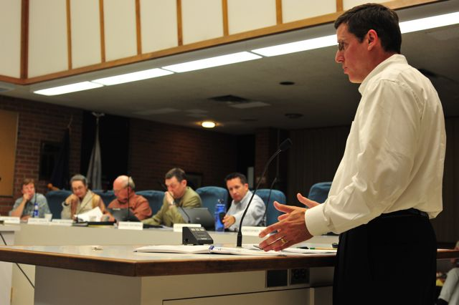
Why webcasting works for Cities and Municipalities
This generation is web savvy and has an expectation to online access to:
Council and Committee Meetings
Media Releases
Public Service Announcements
Health and Safety Messages
Budget Meetings
Election Coverage
Contextual messages explaining policy

Slide 6
Why webcasting works for Cities and Municipalities (continued)
This generation is web savvy and has an expectation to for:
Convenient access to live and archived material
Transparency to municipal government
Webcasting provides “true” representation. There is no room for spin or any messages to come out of context.
The audience will see and hear the content as it happened

Slide 7
How it Works
Install Video Camera and position accordingly
Hook up to Encoder to Dedicated Internet and camera/audio
Webmaster to create a page on your site for Live and Archived Webcasts
When ready to go live, Flip the on switch “On”
When webcast is finished, Flip the switch to “Off” and the Webmaster will then add a link to archived material so viewers can watch at their leisure

Slide 8
CITY AND MUNICIPALITY PACKAGE OFFERINGS - $7500 / year
INCLUDES:
The ability (hardware/software) to capture and stream Live from Council Chambers
Archived material is hosted by ISI and available on your website
Unlimited number of viewers for live and archived material
Access to metrics of your Live and Archived viewership (#of viewers, etc.)
Dedicated DSL connection into Council Chambers
Hardware monitoring and replacement if failure occurs
24 X 7 Support
*Incentives for multi-year contracts
Discounted prices
Camera options
Etc.

Slide 9
Webcasting in the Municipal Government
Questions?

