Slide 1
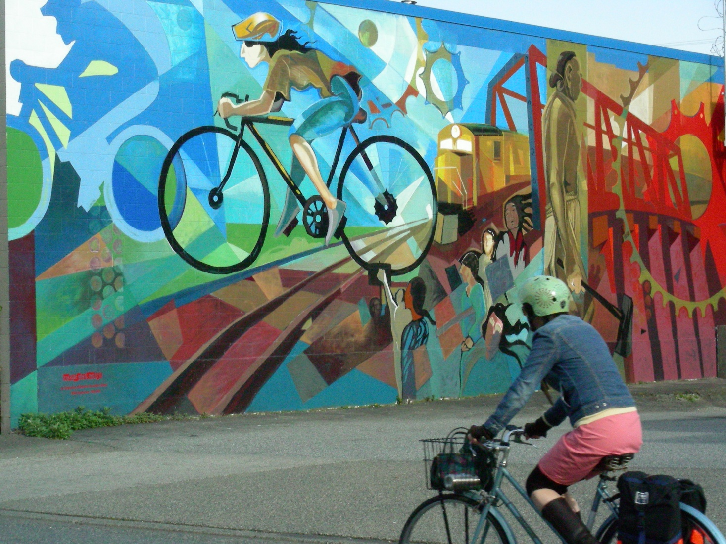
CAA Presentation People who Cycle, the Local Retail Economy, New Business Opportunities
Meeting Agenda
Vancouver
2011-05-25

Slide 2
CAA Presentation The Bike – Car Relationship
The Business Cycle
Corporate communities supporting and benefiting from cycling
Experiences for making this a viable relationship
Cycling-related business
Local retailing
Local businesses integrating cycling into their business and marketing models
Combined Mobility opportunities

Slide 3
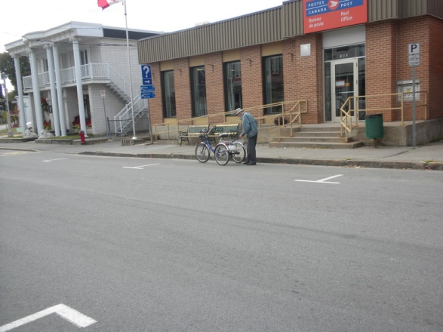
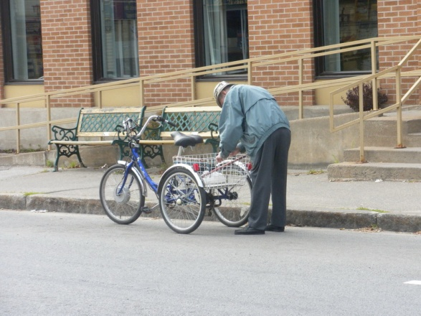
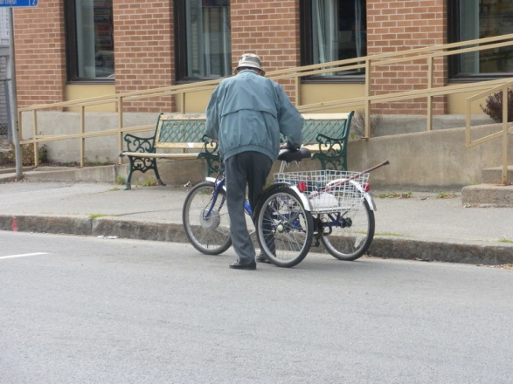
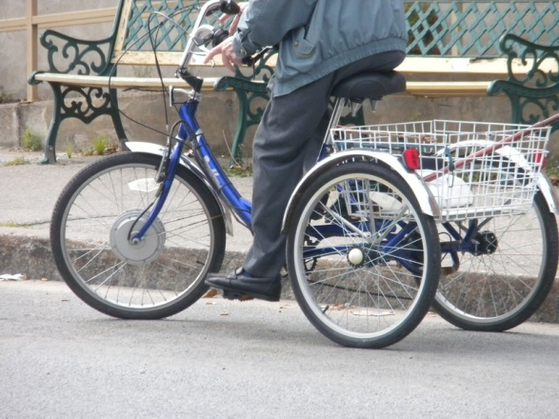
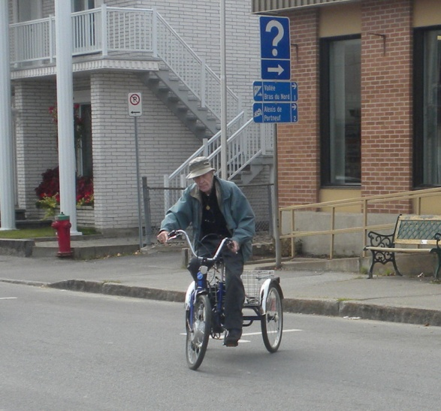
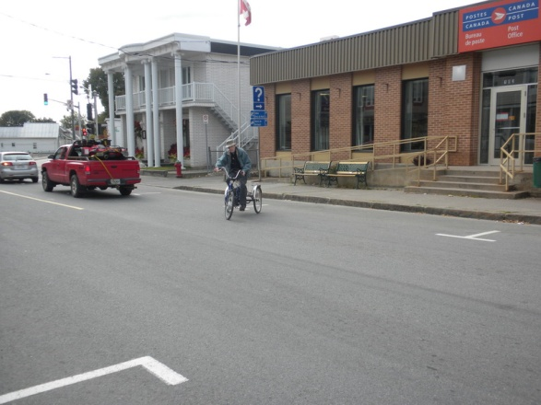
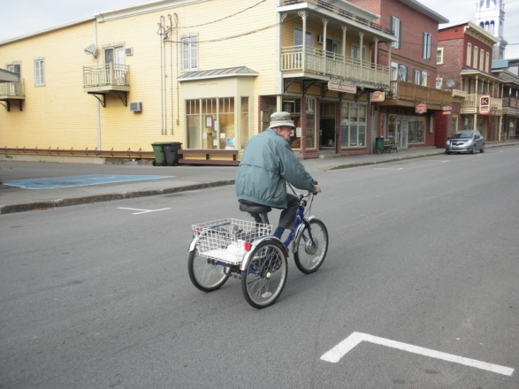
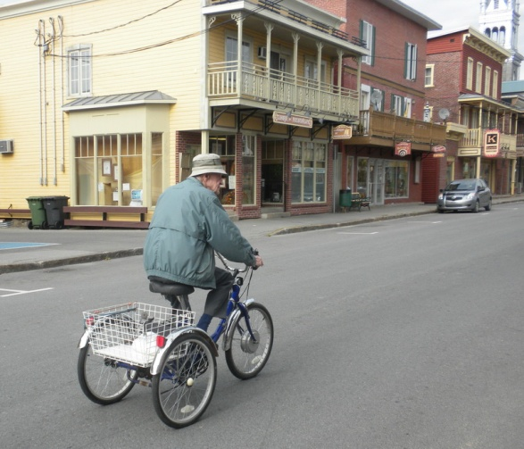
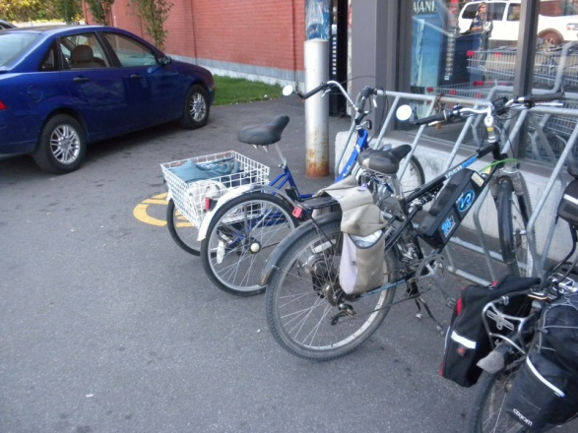
CAA Presentation People who Cycle, the Local Retail Economy, New Business Opportunities
Notes:
These pictures were taken in St. Raymond du Portneuf, about 60 km north-west of Québec City, a town along Québec’s La Route Verte cycling touring network. The man was coming out of the post office and on his way to the grocery store.
Now just fast forward about 12 to 15 years, then it will be me taking out my electrical-assisted tricycle for the daily shopping trip, making my way from my home in the downtown peninsula to the shopping areas downtown, and stopping at my favourite shops.
By then, PEOPLE won’t be MOTORISTS or CYCLISTS. They will be PEOPLE. As they leave their home for a trip, they may take their car keys, or their transit pass, or decide to walk, or take a public bike at the corner, or take their bicycle. They will be PEOPLE taking the appropriate transportation alternative for that trip, recognizing their commitment and their contribution to a sustainable, liveable, green community. They will do their part to keep the city green.
The Business Cycle
Corporate communities supporting and benefiting from cycling
Experiences for making this a viable relationship
Cycling-related business
Local retailing
Local businesses integrating cycling into their business and marketing models
Combined Mobility opportunities

Slide 4
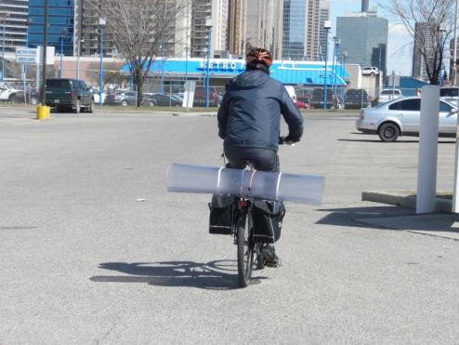
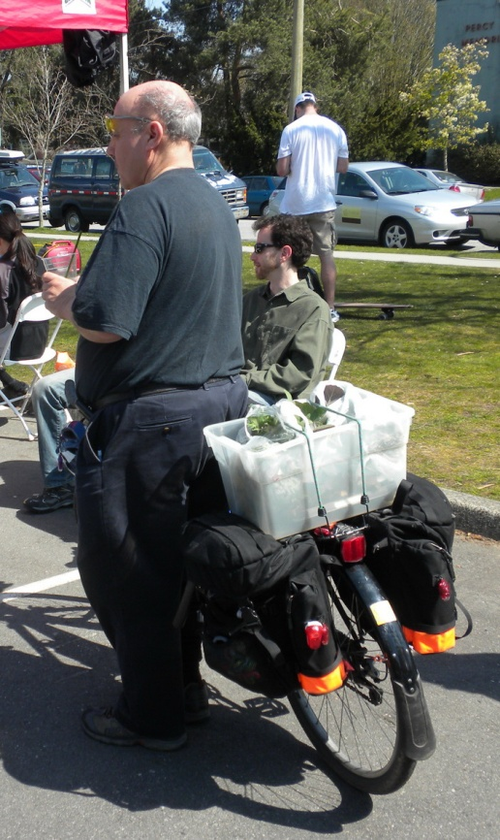
CAA Presentation Cyclists as Customers
Cyclists as Customers
Retailers should target cyclists, pedestrians and transit riders as their preferred customers no matter if they are owners of cars or non-owners
They have more disposable money available for spending at retail stores or service establishments
Cyclists, leaving car at home,
$ 7.50 plus on each trip, including parking
Cyclists, without a car,
$30 per day or $11,000 per year, including home parking
Retailers
Sales revenue from bicycle parking space exceeds that of car parking
$31 compared to $6 per sq. metre of parking space
Greater opportunity for higher profit, discretionary sales for retailers
Cyclists tend to buy less per store visit but come in more frequently.
Notes:
Cyclists, pedestrians and transit riders should be retailers’ preferred customers, no matter if they are car owners or not
Street traffic is so important to retailers. If there is traffic on the street, then there is opportunity for retailers to convert that street traffic into store traffic and then into sales. For purpose of discretionary shopping, street traffic is very hard to stop and have it come into a store. Street speed is too fast for inducing the shopping feeling. (just look at the Danforth experience in Toronto) Car parking is usually not readily available in front of a retailer’s store and may be several blocks away. That is everyday reality on a shopping street. Parking may be far enough away where the driver decides to forget about that discretionary purchase and decide to go to a suburban mall instead.
Cycling provides a convenience while providing a means to take home one’s shopping. Some form of parking is usually found within the catchment area of a store. Cycling speed is more conducive to stopping for discretionary shopping.
Retailers should be thrilled with the thought of bike parking corrals in front of their stores. Instead of one parking spot occupied by one potential shopper, now a retail store is exposed to higher street traffic and 10 to 14 potential shoppers. As a bonus, these shoppers have more money available for spending on purchases or other local services, including the hospitality trade.
For each trip, a cyclist has an additional $7.50 available for shopping. The cost of transportation for a cycling shopper is much lower than driving a car to a store. No need to pay for parking, motor fuel, and car maintenance. The appeal of a cycling shopper increases to retailers if the shopper has moved totally away from driving to cycling or combining cycling and transit. Now, there is about an additional $30 available each day for more shopping or for something special.

Slide 5
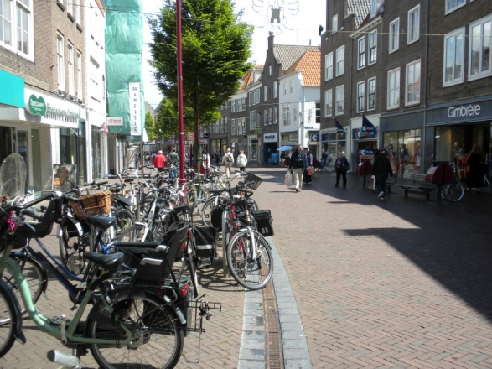
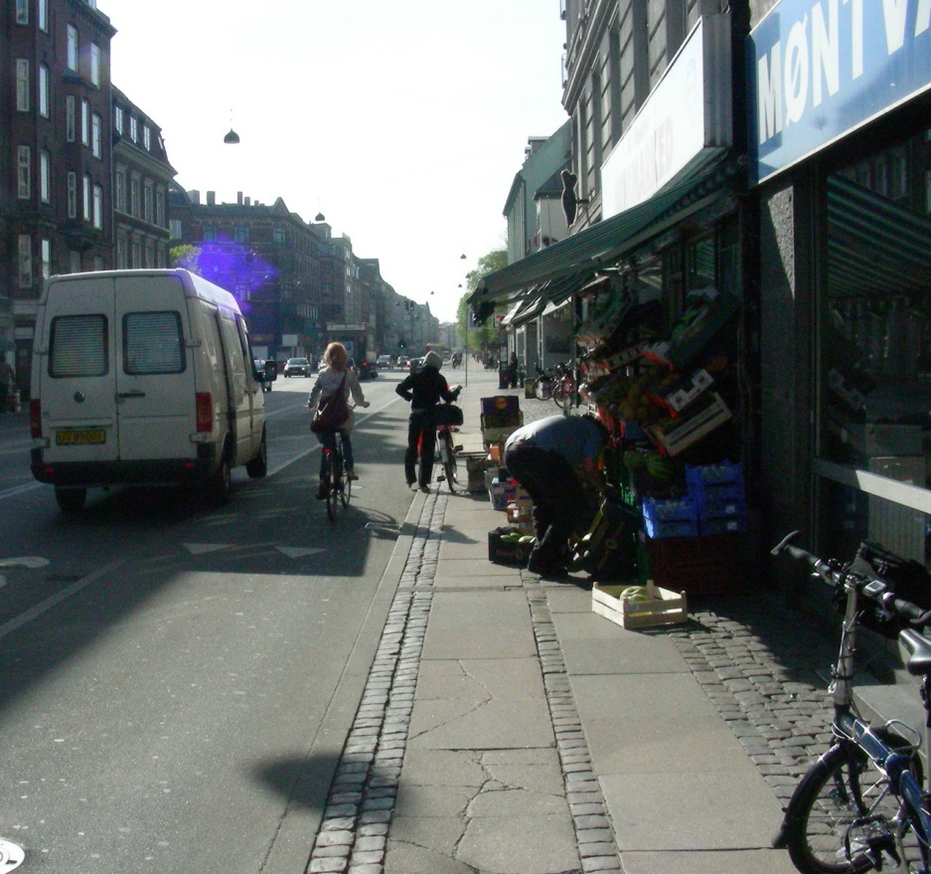
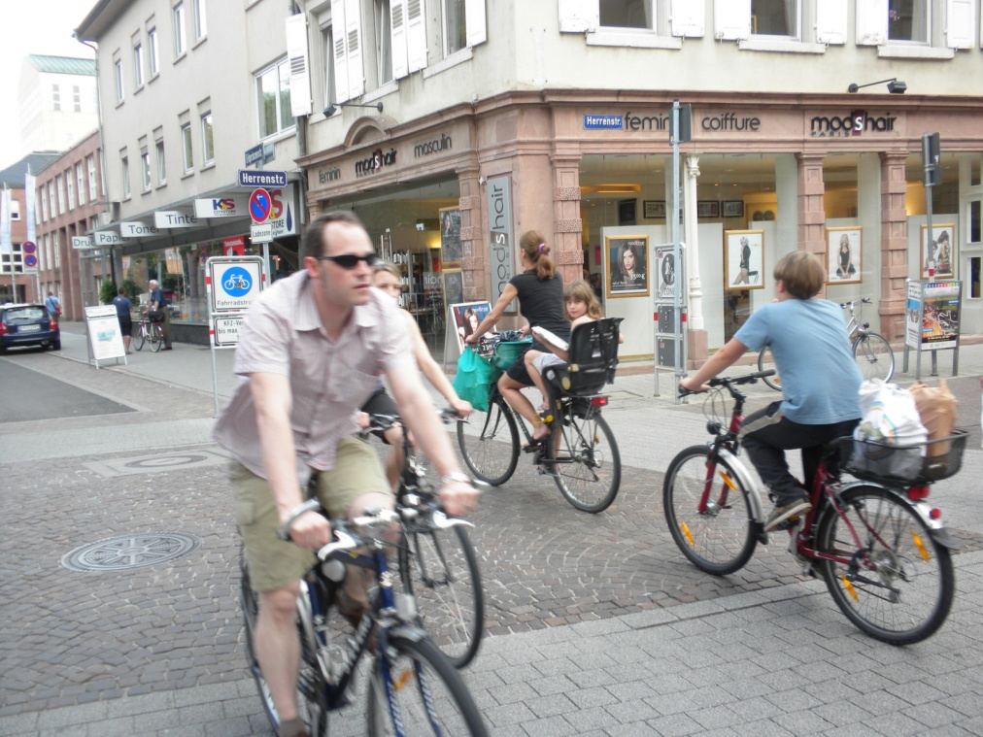
CAA Presentation Getting Cyclists to Stores
More people will cycle to stores if
There is separation between cars and cyclists
Visibility of cyclists passing through intersections
Car speed approaches that of cycling
Notes:
A social experience!
Dr. Kay Teschke’ Cycling in Cities Survey indicated that there are a significant number of people who would cycle for their transportation needs if only the road system were to their liking. (31% in the city of Vancouver of which about 12% cycle at least once a month). High on the list of needs are Separation and Intersection Visibility.
Focusing on streetscape and enhancing the cycling experience to get to stores is a way for increasing retail activity along a street. Speed of neighbouring car traffic is a significant factor. As pedestrians, we know how we value separation from faster modes of travel. The same holds for cycling. Shopping areas adjacent or within the catchment area of cycling facilities helps one decide where to go for one’s shopping needs. In Europe, from towns and from small to large cities, highly visible cycling facilities bring shoppers to the shopping core. These sometimes include separation of cyclists from other traffic.
For bringing in customers who want to cycle there, a direction taken by shopping centres is to provide cycling lanes connecting to convenient and highly visible bike parking on shopping malls. Two examples are highlighted; one is a shopping mall outside of the city core in Copenhagen. The other is from a suburban mall adjacent to the Highway 95 Bikeway east of Spokane WA.

Slide 6
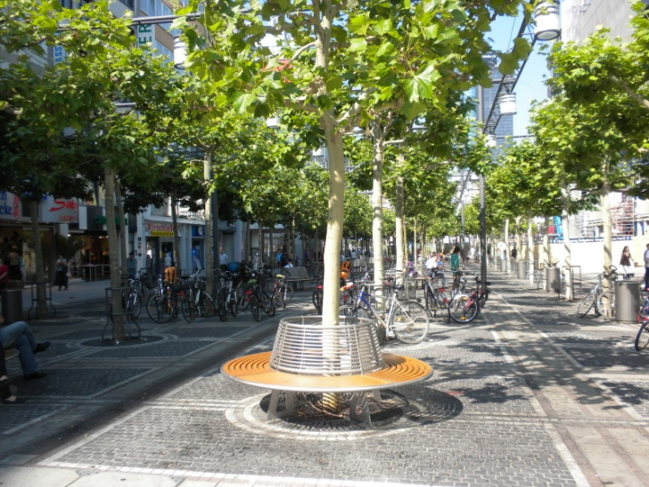
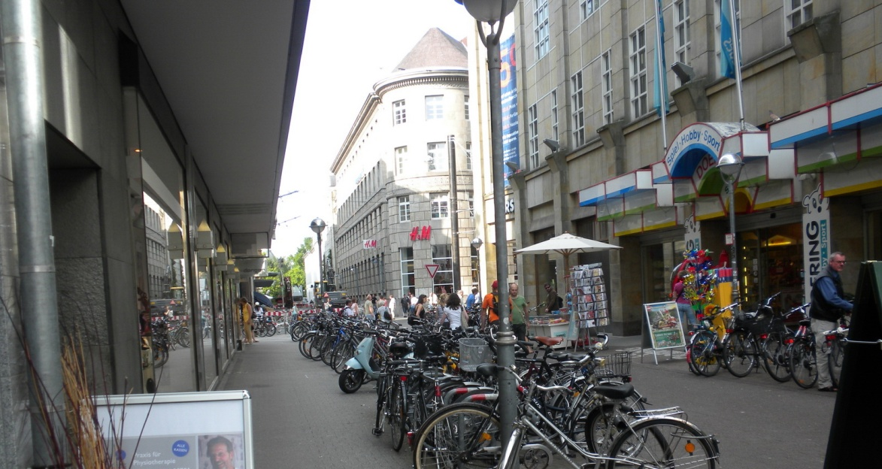
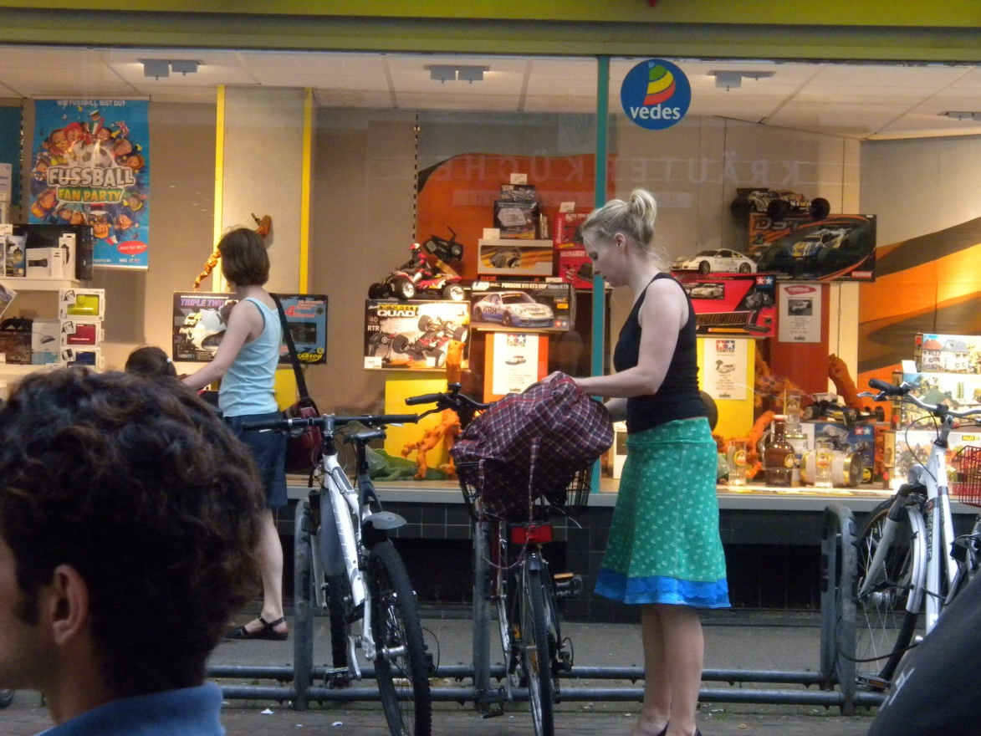
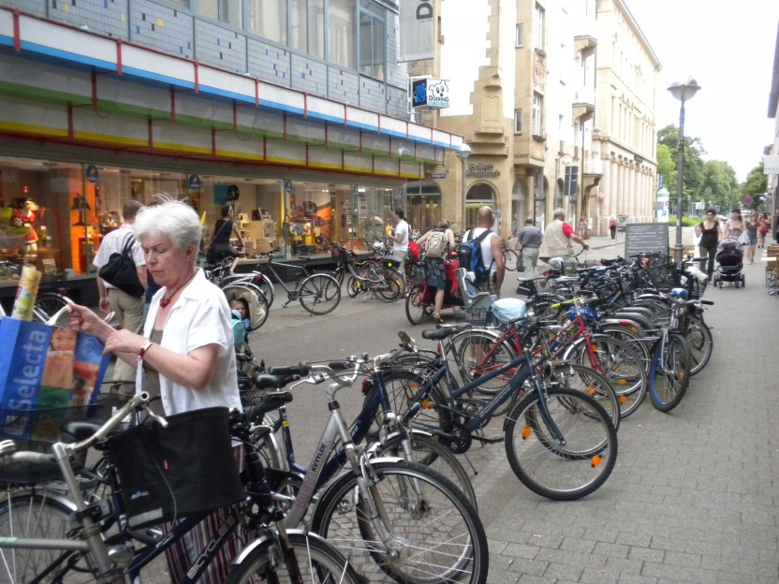
CAA Presentation A place where people want to be – Streetscapes which attract cyclists as shoppers
People streets
Car movement controlled
Hours of day
Delivery of goods
Residents on street
Notes:
As we know, shopping areas compete with curling and hockey rinks and Tim Horton as places where people can congregate for social experiences. In Europe, from small to large municipalities, shopping streets are enhanced to be People Streets. These People Streets provide connectivity to stores and to places of business. These highly popular streets for shoppers and for retailers of all sizes and line of business provide passage for pedestrians, cyclists, sometimes transit, delivery vehicles and local residents at low speed, usually 20 kph or less.
Next slide

Slide 7
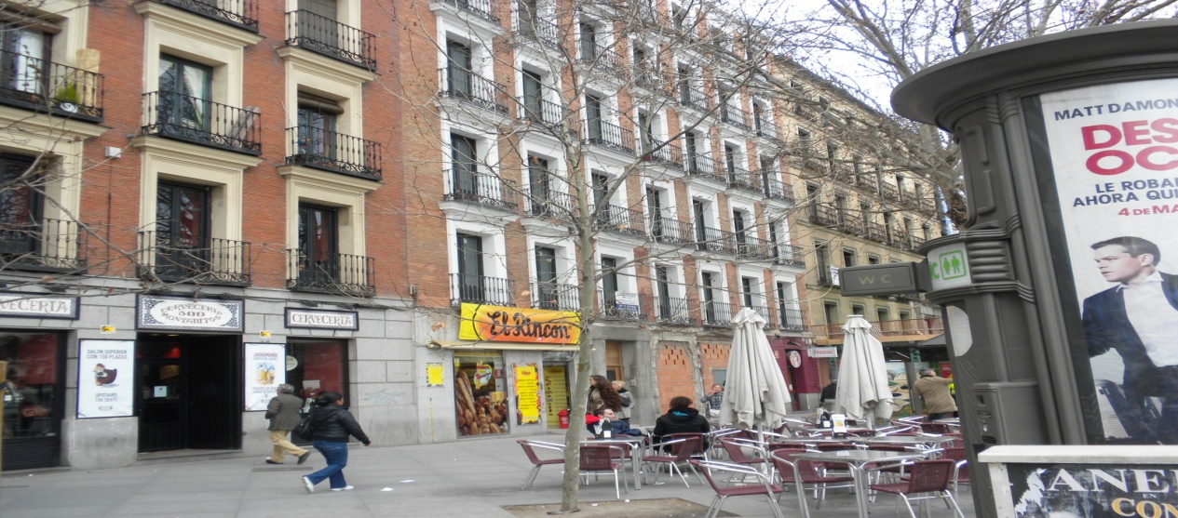
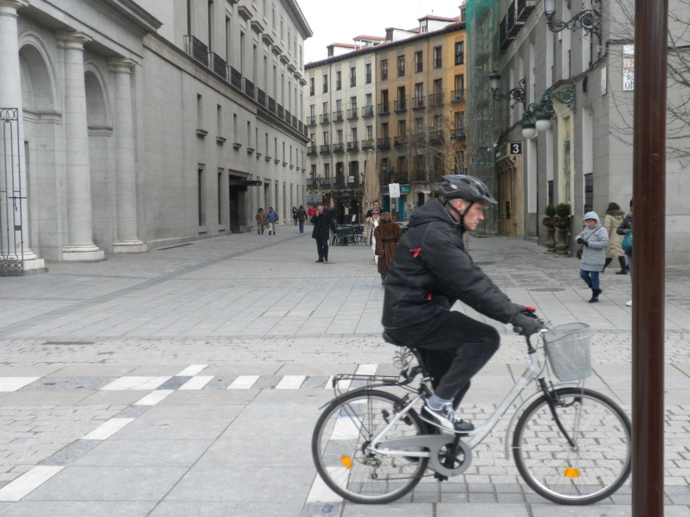
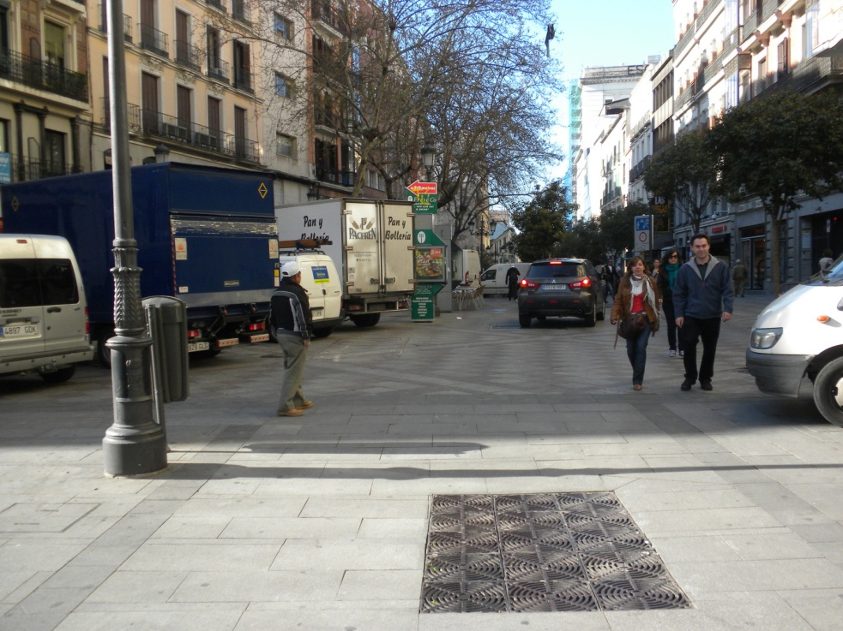
CAA Presentation A place where people want to be – Streetscapes which attract cyclists as shoppers
People streets
Car movement controlled
Hours of day
Delivery of goods
Residents on street
Notes:
These streets provide room for people to stop and enjoy life. Transportation Demand Management methodologies are used. Frequently these streets are open to all traffic until 10:00 to 11:00 am. Automatic bollards are frequently used to control access.

Slide 8
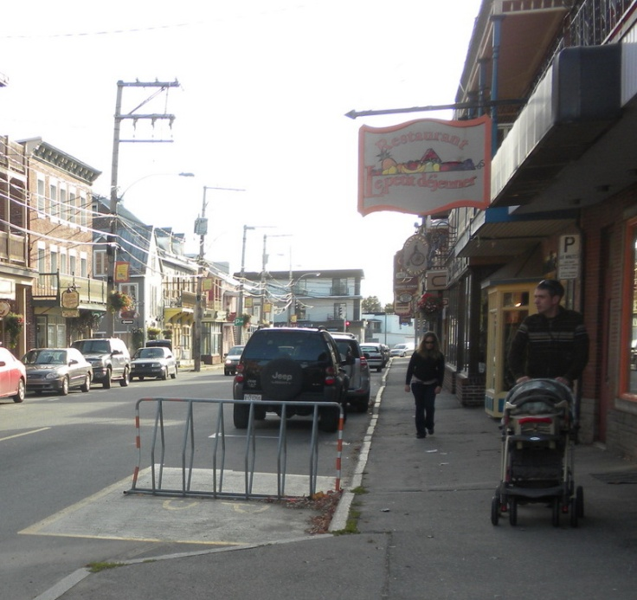
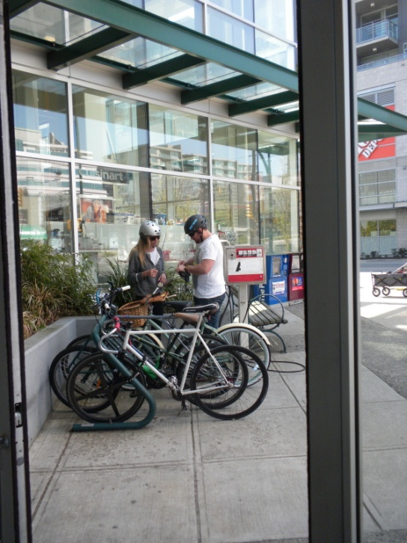
CAA Presentation A reason for going there to shop - Businesses appealing to cyclists
Retailing to city residents
Local, neighbourhood shopping
Regional stores
Specialty shops
Bike-related
Others
Big box stores
Providing services
Tourism and entertainment
Hospitality and foods
Accommodations
Attractions
Provider of everyday living needs for locals
Offering specialized goods and services
Not available in suburban malls or stores
Notes:
If businesses are going to be successful over the long term, their marketing approach along with their goods and services offerings for sale will need changing and adopting with time as consumers’ taste and mobility changes. This is especially true for downtown areas which may see significant population growth, especially residential growth. If stores do not offer something distinctive, then why go shopping there, especially with stores located downtown rather than closer to home or in suburban malls and shopping areas.
Shopping traffic on streets is all important to retailers. As streets are restricted in width, car traffic may also be limited which in return limits how many people can drive to shopping streets. Transit, cycling, and walking are much more flexible in helping increase the shopping traffic on streets.

Slide 9
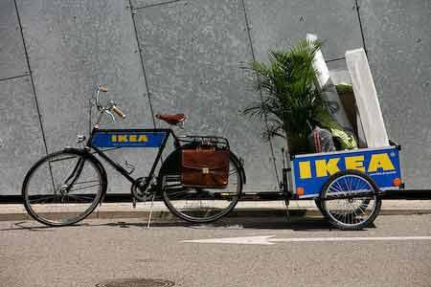
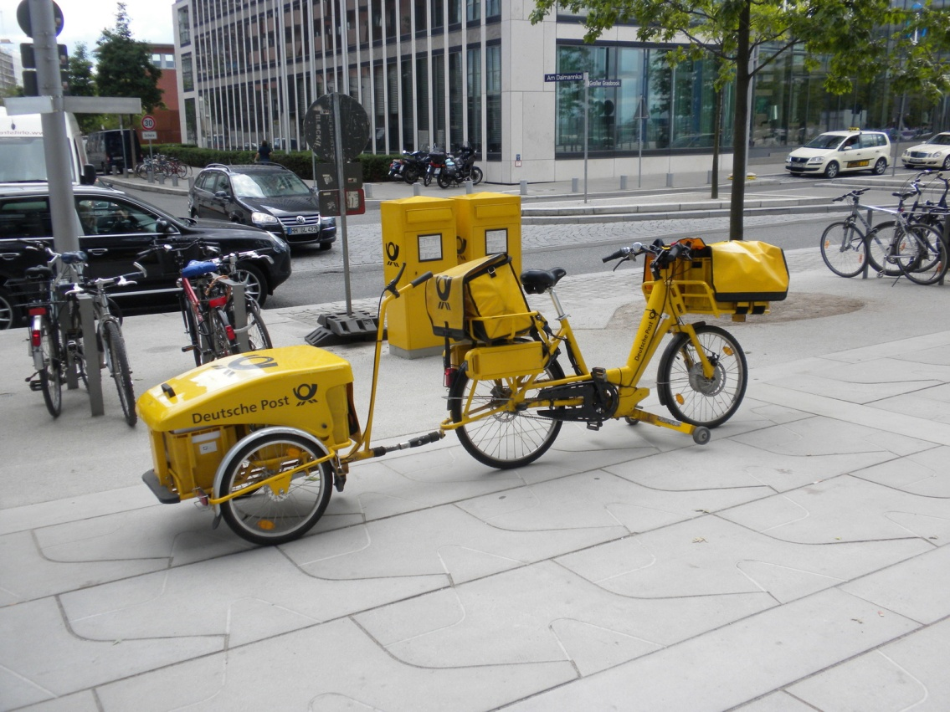
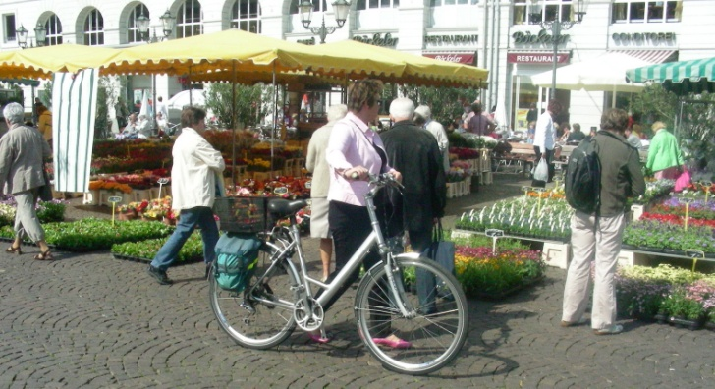
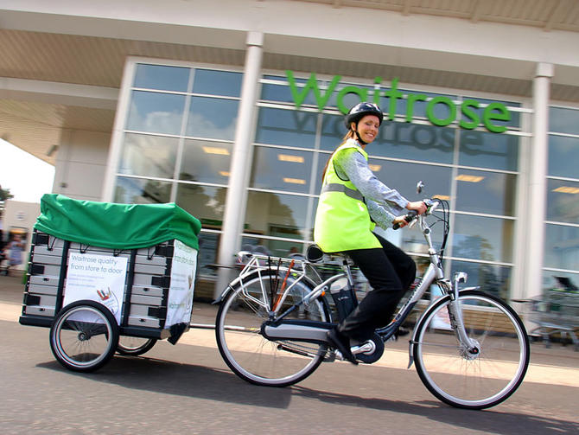
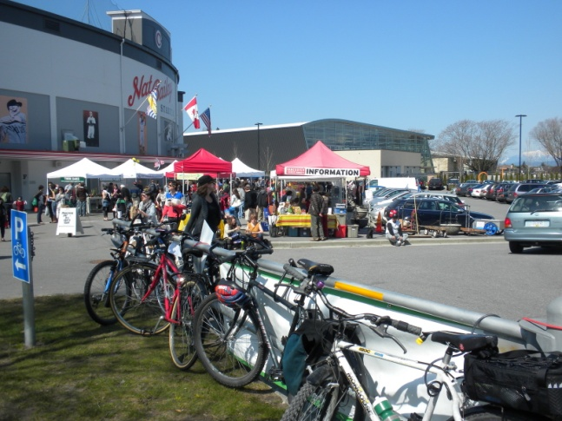
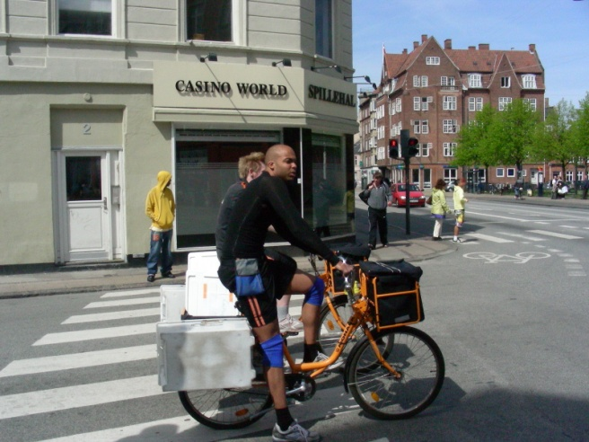
CAA Presentation New business opportunities
Retailing - Take your purchase home
The delivery systems
Supports revitalizing Farmers Markets
Notes:
With increase in cycling traffic comes new opportunities
With movement to cycling and combining cycling with transit, new business opportunities appear. As cycling traffic grows, so does retailing in bike stores. However, other opportunities also become more viable, including specialized business operations.
The Delivery Systems
One area undergoing development is the courier business. Some mail delivery services have expanded the capacity of a mail person to carry the cargo. Some retail operations have returned to the way of providing home deliveries of the 1950’s and before using cargo bikes. Other retailers have moved beyond their normal home delivery services and the take it home yourself truck rental program offering to provide a cycling delivery option.
Public Bike Systems and shopping
Bike sharing provides new mobility options which extends one’s shopping area, conveniently and time efficiently, without the bother of moving one’s motorized vehicle and finding a new parking spot. Bike sharing provides a linearity of trips with transit. It also helps getting tourists to the stores. For maximizing the effect of bike share on a community and for retailers, high-quality cycling infrastructure is needed, including separation of cyclists and motorists.
Bike stations
As shopping becomes more of a cycling activity, a place to leave one’s bike and be comfortable that it will be there in cycleable condition when one returns becomes more important. Safe parking for bicycles will be in demand while cyclist is shopping at multi-locations. What also will be in demand is a place to leave one’s purchases while the shopping trip continues.
Bus and Bike – Seville, Spain’s solution to moving commuters to their place of work. A ticket will take you from one end of the journey to the other with part by bus and part by bike.
Bike Kitchens – Mobile workshops bringing repair services to cyclists.
Binners – Part of our recycling program. Bicycles and electrical-assisted bicycles as part of the freight network.
Supports Revitalizing the Farmers Market

Slide 10
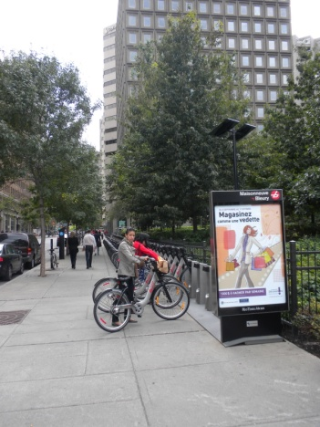
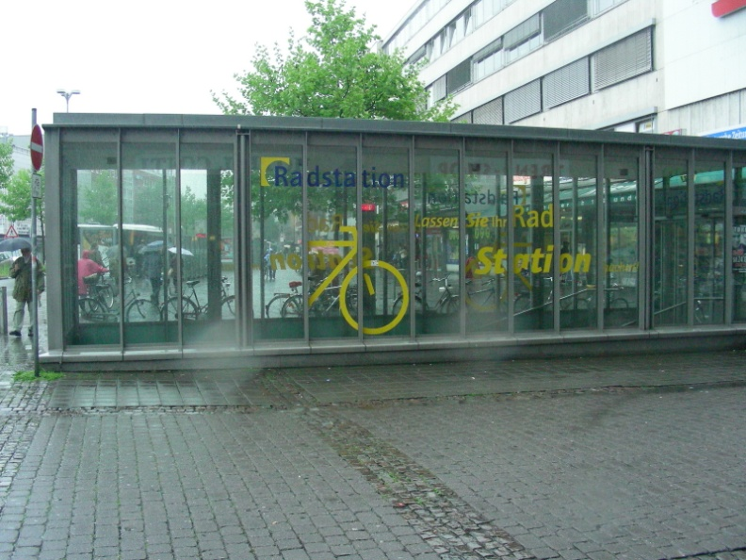
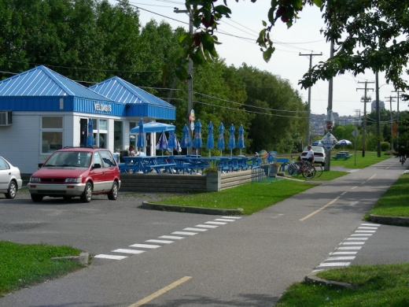
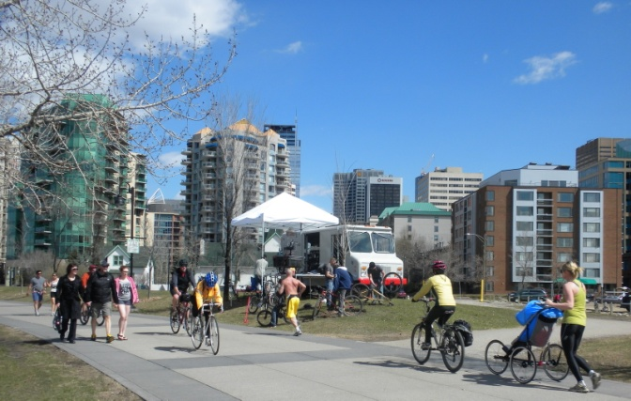
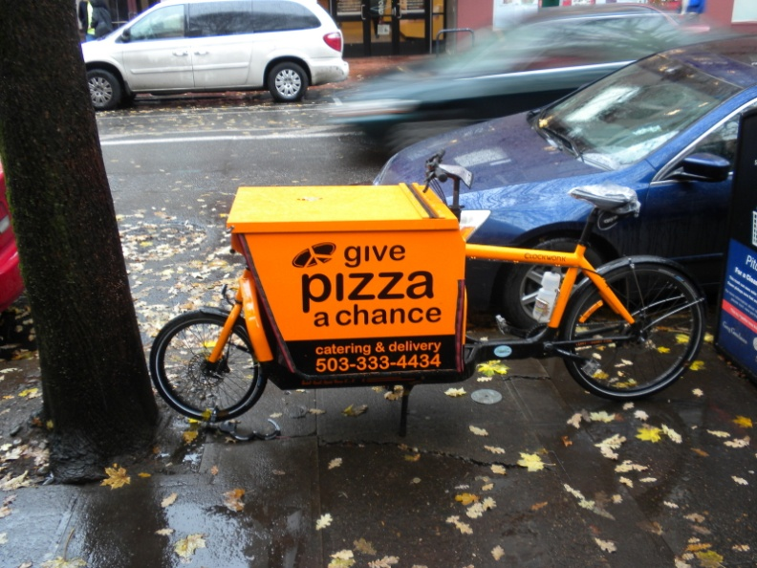
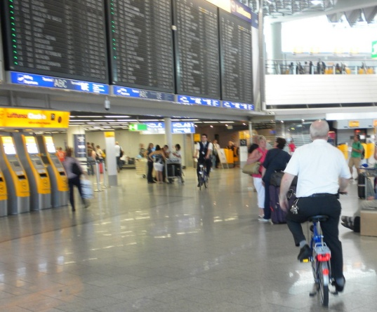
CAA Presentation New business opportunities
Public bike systems – linear trips and shopping
Combined mobility
Bus and Bike concept
Bike stations
Cyclist-focused businesses
Bike kitchen
Bike paths
Bikes as part of local retailing or providing services
Notes:
Public Bike Systems and shopping
Bike sharing provides new mobility options which extends one’s shopping area, conveniently and time efficiently, without the bother of moving one’s motorized vehicle and finding a new parking spot. Bike sharing provides a linearity of trips with transit. It also helps getting tourists to the stores. For maximizing the effect of bike share on a community and for retailers, high-quality cycling infrastructure is needed, including separation of cyclists and motorists.
Bike stations
As shopping becomes more of a cycling activity, a place to leave one’s bike and be comfortable that it will be there in cycleable condition when one returns becomes more important. Safe parking for bicycles will be in demand while cyclist is shopping at multi-locations. What also will be in demand is a place to leave one’s purchases while the shopping trip continues.
Bus and Bike – Seville, Spain’s solution to moving commuters to their place of work. A ticket will take you from one end of the journey to the other with part by bus and part by bike.
Bike Kitchens – Mobile workshops bringing repair services to cyclists.
Binners – Part of our recycling program. Bicycles and electrical-assisted bicycles as part of the freight network.
Supports Revitalizing the Farmers Market

Slide 11
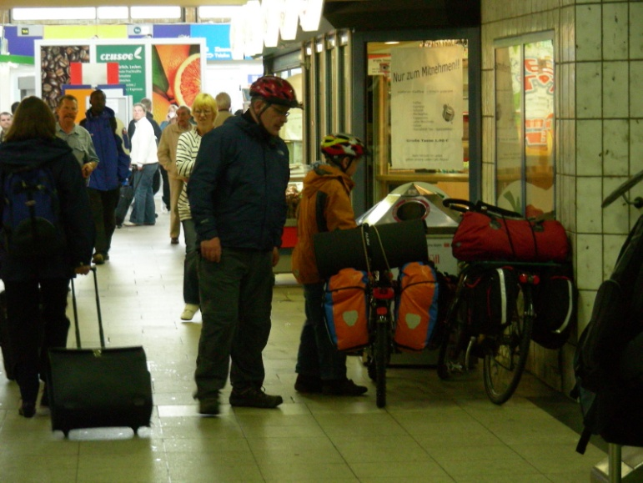
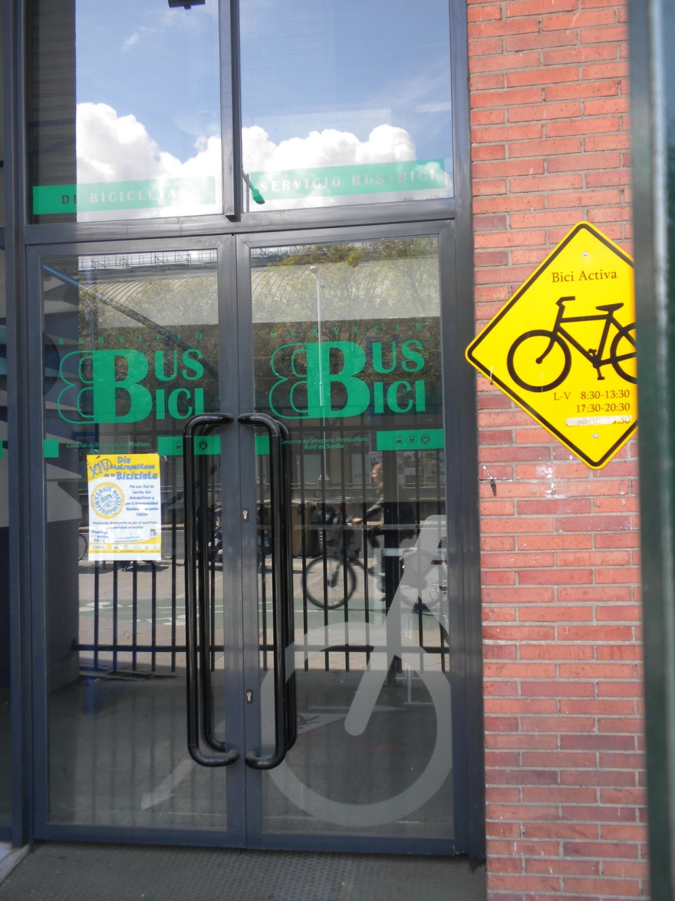
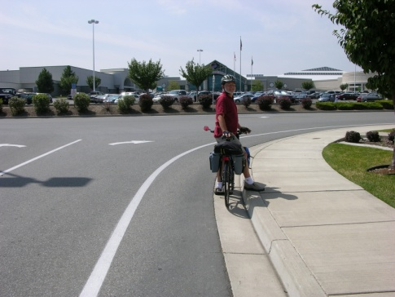
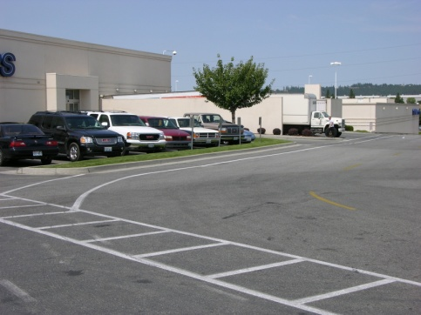
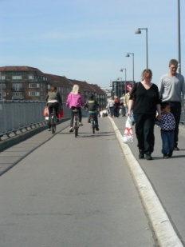
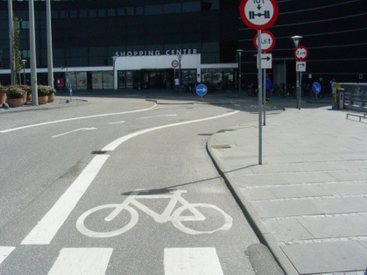
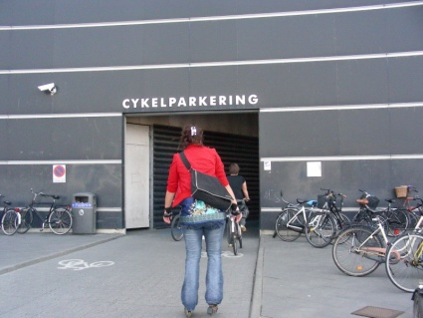
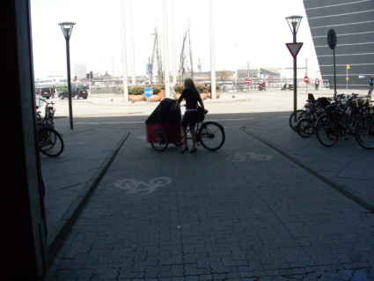
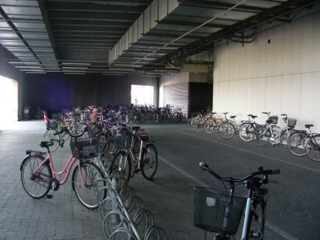
CAA Presentation Observations
Cycling will make a greater contribution to retailing activities
and the local economy, if
People sense a comfortable and perceived safe way to get
to stores
Separated bike lanes on-roadway or off-roadway
People have options for trips
Combined mobility options with cycling and transit, cars
Public bike systems
People can relax and enjoy themselves when
shopping
People Streets opened up to walking and cycling,
limiting car movement

